Slide 1
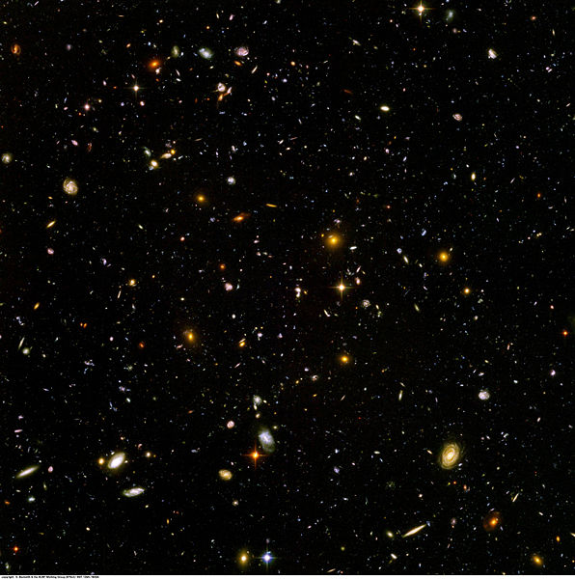
A Journey Through the Universe
David Le Conte, FRAS
Astronomy Section
La Société Guernesiaise
Guernsey
Notes:
In this presentation we are going on a journey from the Earth far out into space, through our solar system and beyond to the stars, the galaxies and the limits of the known universe.

Slide 2
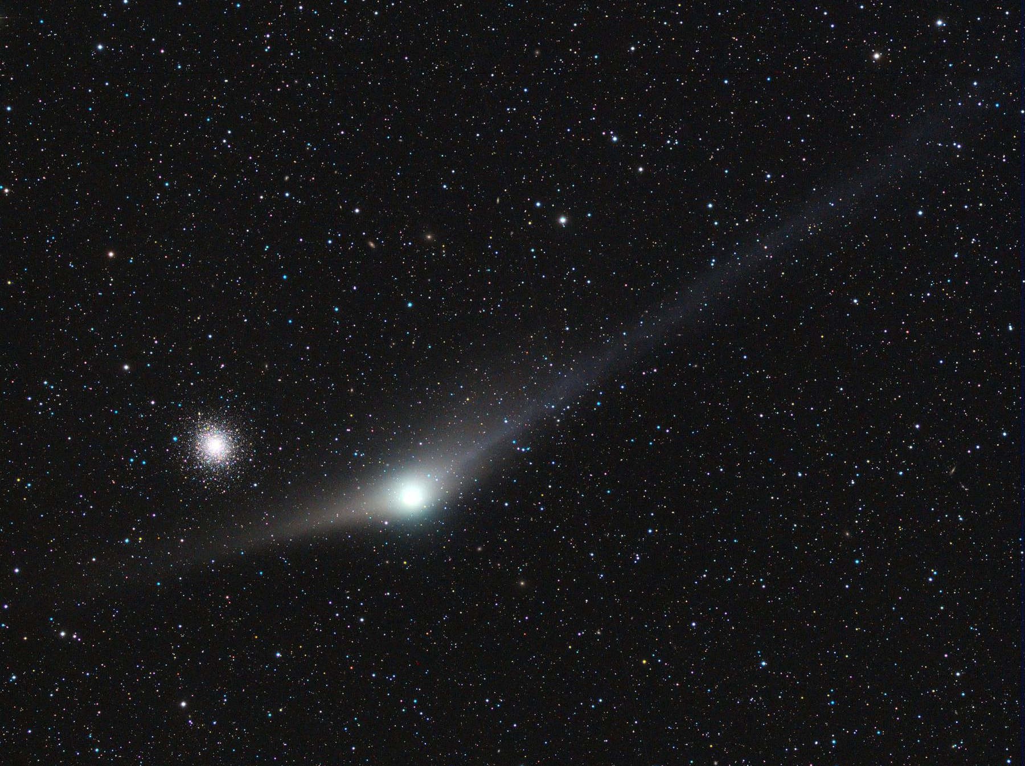
The star cluster is over a billion times further away than the comet!
Objects which appear similar may be very different things and distances.
M92 globular star cluster
25,000 light-years
Comet Garradd
12½ light-minutes
Rolando Ligustri
Notes:
Now, let’s start off the presentation by getting an idea of the distances involved. Here are two objects which look somewhat similar in size and brightness, although not in shape. But they are very different kinds of objects. [CLICK] One is a comet, and [CLICK] the other is a star cluster. [CLICK] It took the light of the comet just 12½ minutes to reach us, but [CLICK] the light from the star cluster took 25,000 years! [CLICK] So the star cluster is over a billion times further away than the comet, and clearly much larger.

Slide 3
Light-years
The speed of light is 186,000 miles (300,000 km) per second
In one minute light travels over 11 million miles
That distance is a ‘light-minute’
In one hour light travels 670 million miles (over 1 trillion km)
In one year light travels 6 trillion miles (9.5 trillion km)
That distance is a ‘light-year’
Notes:
A common unit of distance used by astronomers is the light-year, which is based on the speed of light. [CLICK] Light travels at 186,000 miles per second. [CLICK] So in one minute it travels over 11 million miles, [CLICK] and we can call that distance a light-minute. [CLICK] In one hour it travels 670 million miles, [CLICK] and in one year it travels about 6 trillion miles. [CLICK] That distance is a light-year. So just remember that when we refer to a light-year we are talking about a very long distance.

Slide 4
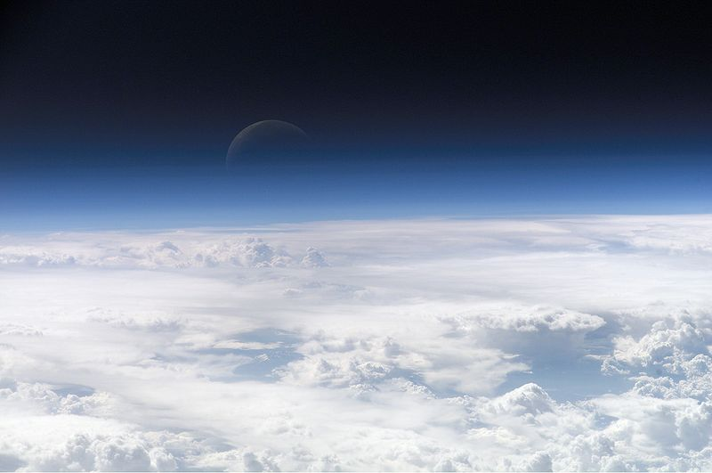
Outer space
About 100 km
Notes:
If we go straight up outer space can be defined as starting at an altitude of about 100 km (60 miles). This is a view from the International Space Station.

Slide 5
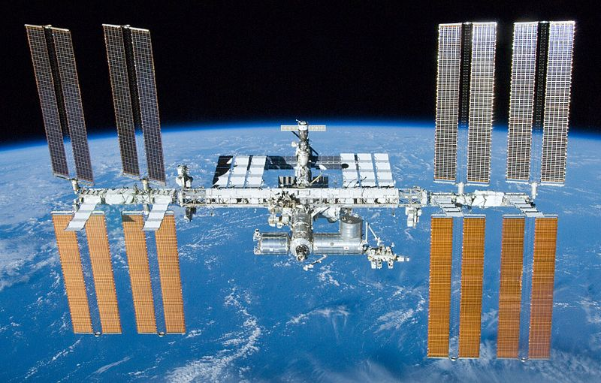
The International Space Station
400 km
Notes:
The Space Station typically orbits the Earth at an altitude of about 400 km (250 miles). It is now about the size of a football pitch, has six astronauts on it, orbits the Earth every 95 minutes, and is easily visible from much of the world, including as far north as the British Isles.

Slide 6
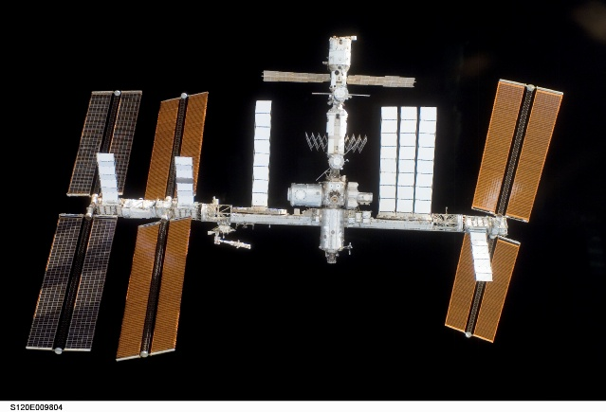
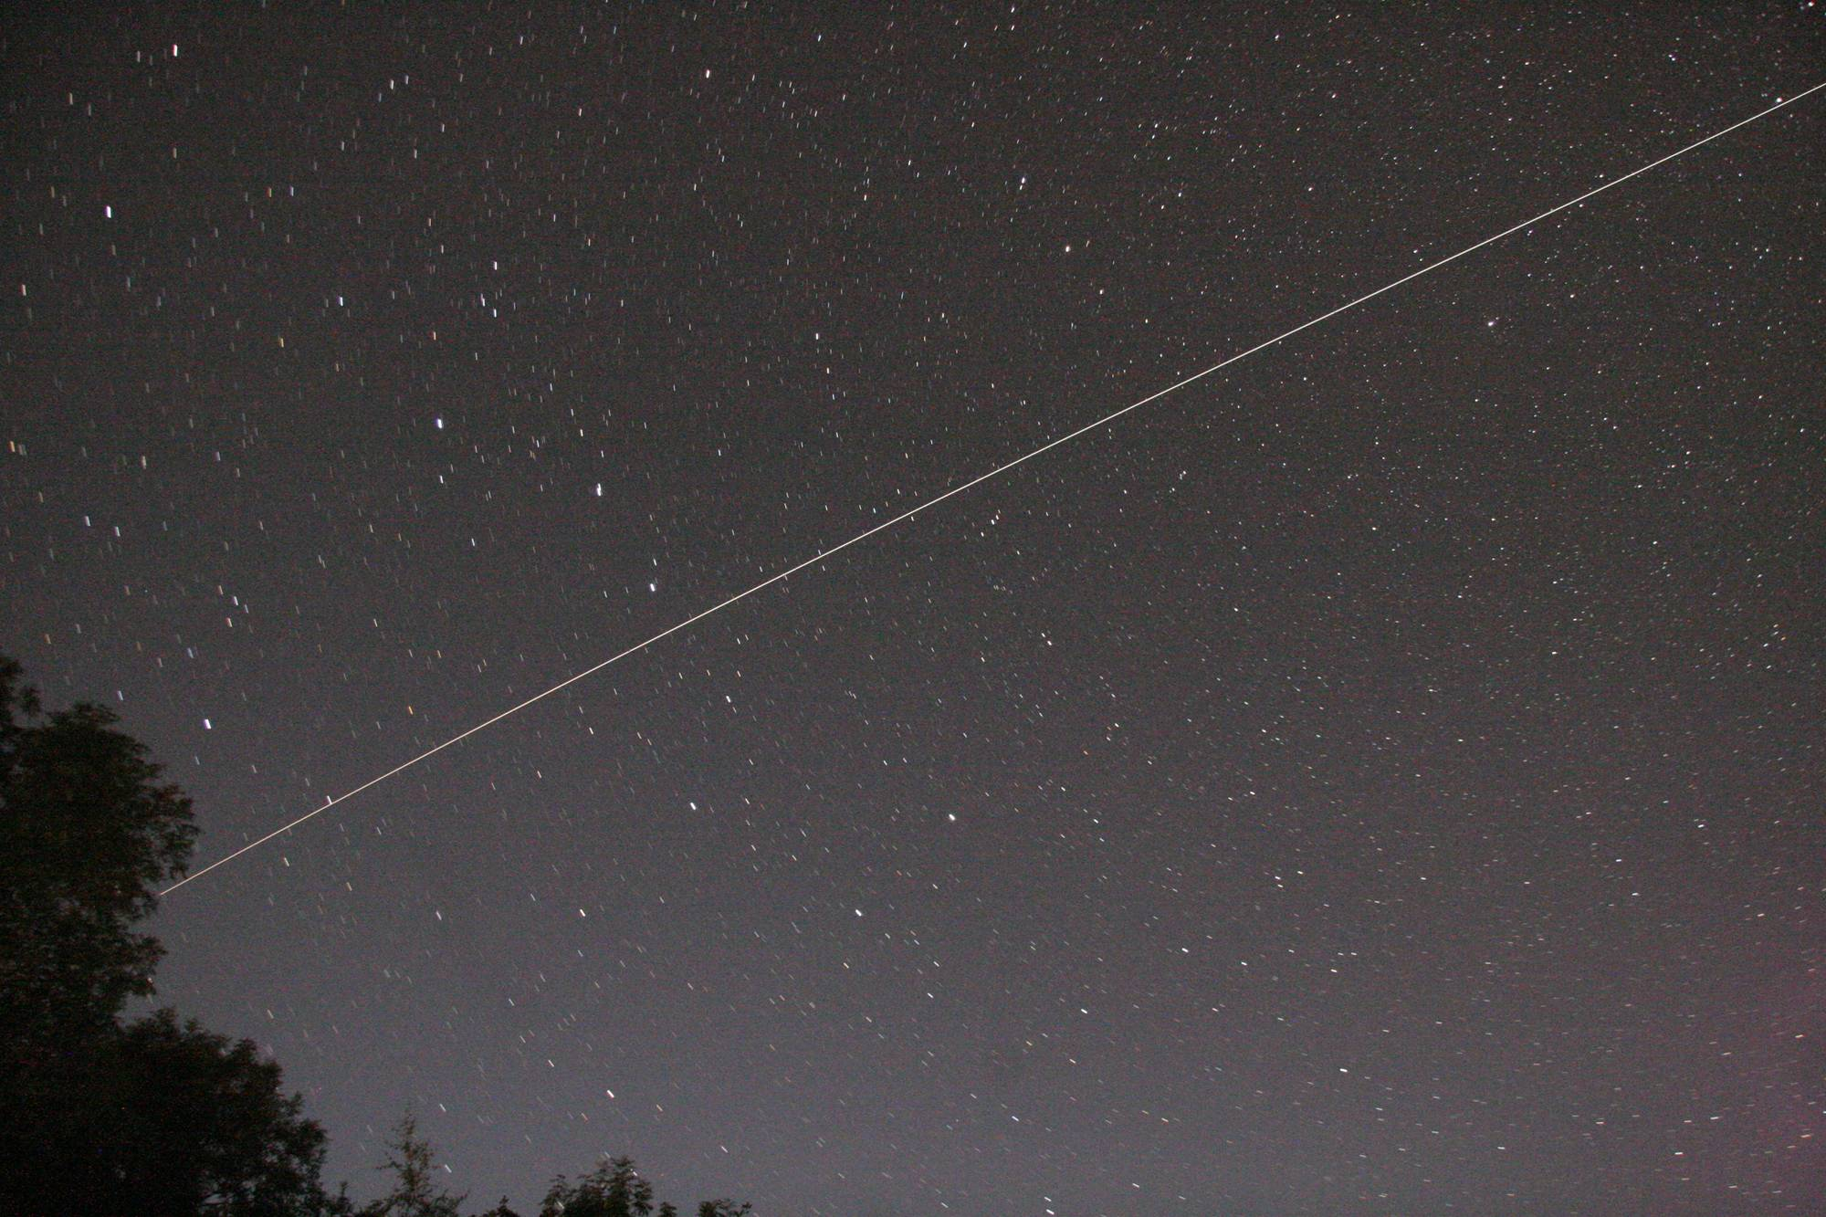
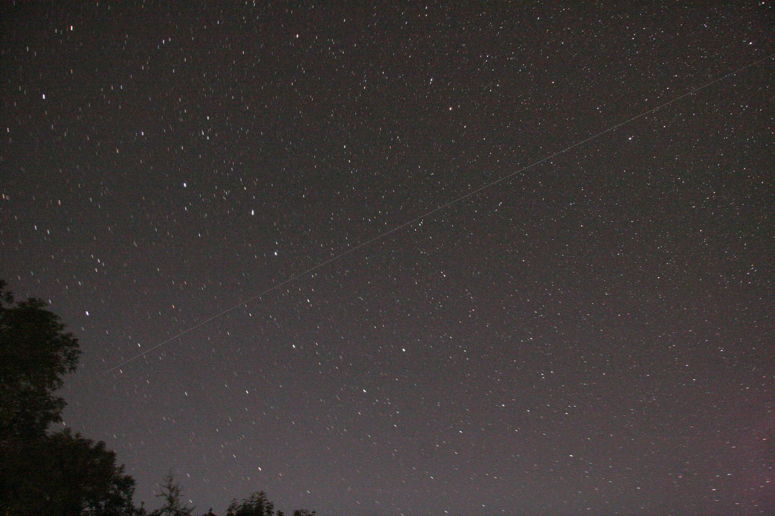
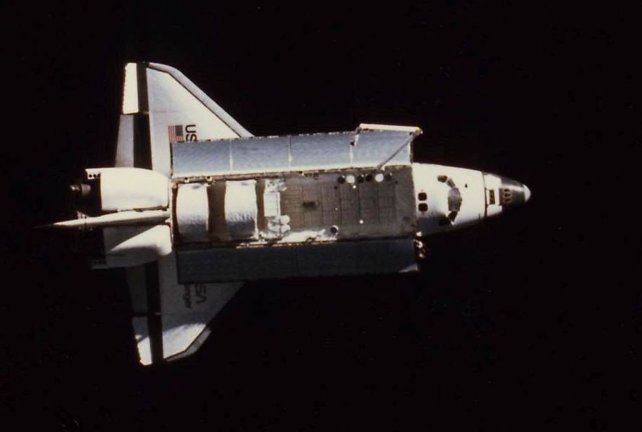
International Space Station going over Guernsey
Space Shuttle Endeavour
(Three minutes after the Space Station)
David Le Conte
Notes:
It is very bright, appearing like a moving bright star, taking several across the sky, usually from west to east. Here is a long time-exposure picture I took of it, [CLICK] followed closely by the Space Shuttle which was to link up with it.

Slide 7
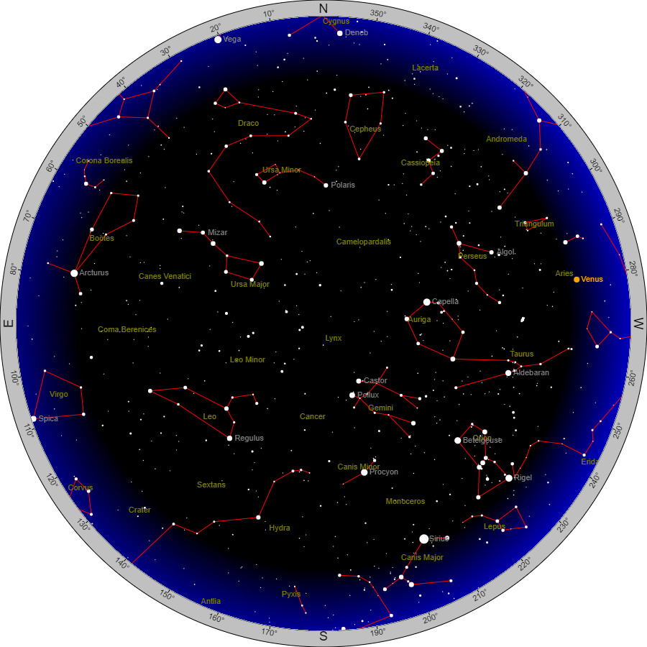
www.
heavens-above.com
The night sky
from Guernsey
9 pm, April 2020
Notes:
The Space Station’s appearance in our skies changes from day to day, and it is necessary to get predictions of when and where it will appear. A number of apps provide this information, and I also recommend a website called Heavens Above, which provides not only predictions for many satellites, but also star charts such as this one.

Slide 8
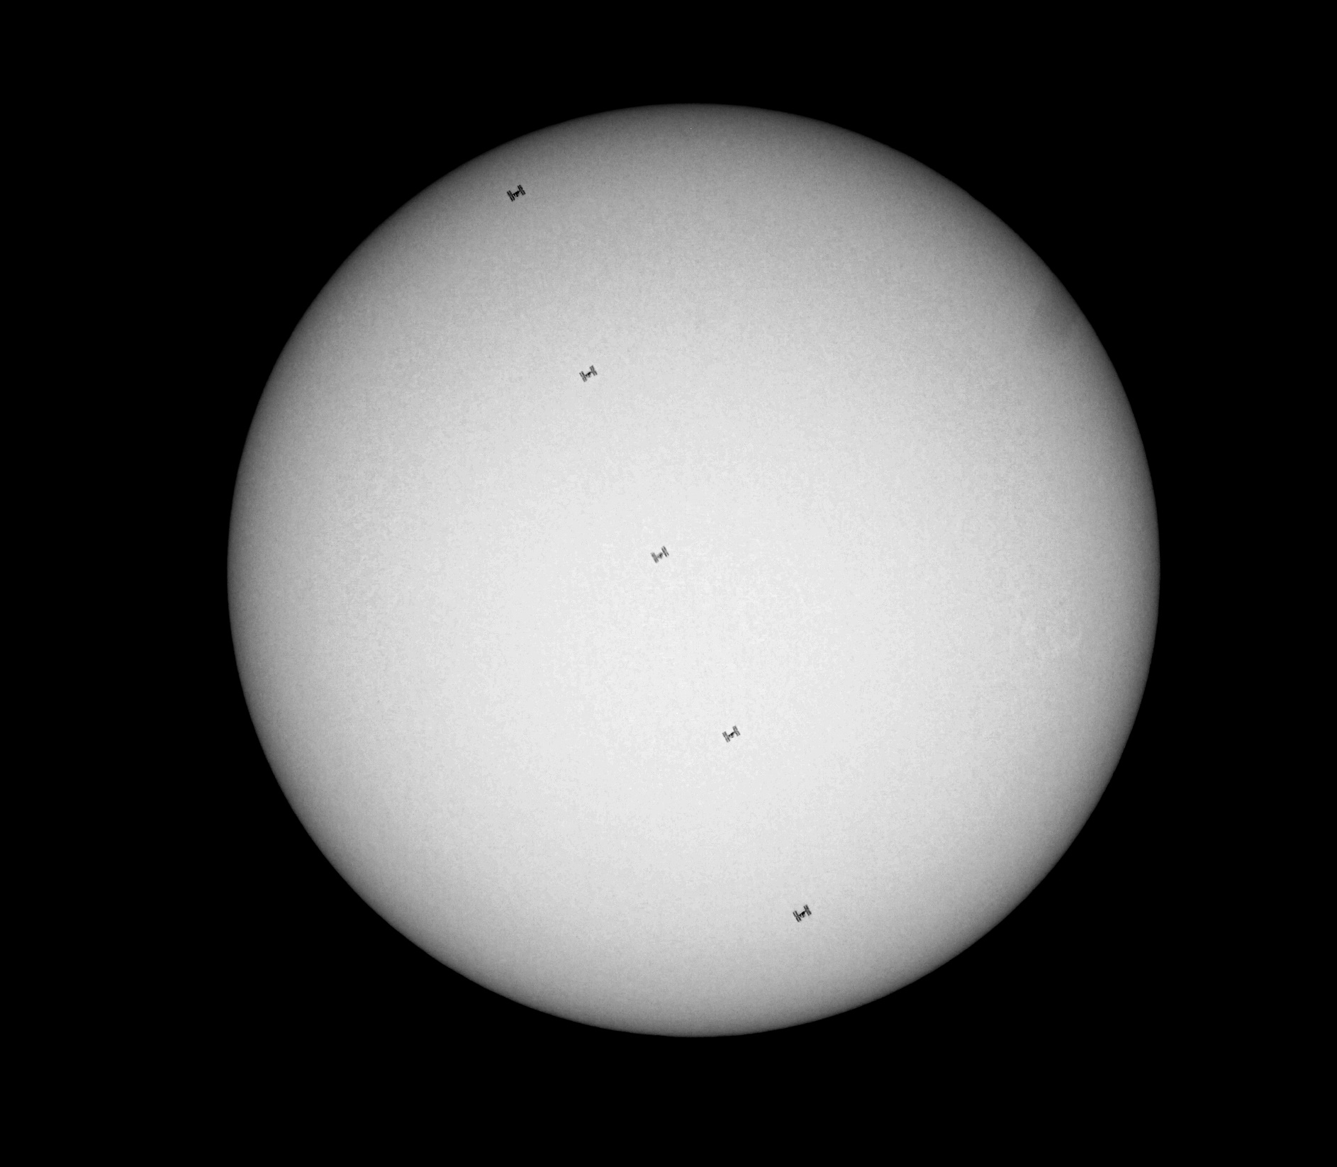
Space Station
crossing Sun
David Le Conte
with Jean Dean
Notes:
Using special equipment I was able to get five images of it crossing the face of the Sun. [CLICK] A blow-up of one of the images clearly shows the outline of the Space Station and its huge solar panels.
[10 June 2017, with five-inch Takahashi refractor, Guernsey Observatory. Taken by David Le Conte; processed by Jean Dean.]

Slide 9
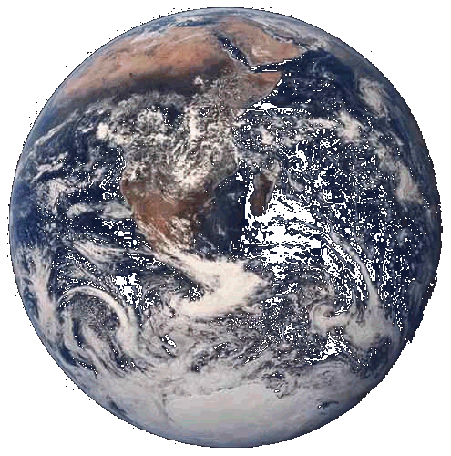
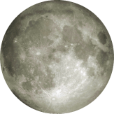
Earth
400,000 km
(240,000 miles)
Moon
Not to scale
Notes:
Our nearest neighbour in space is the Moon, 400,000 km (240,000 miles), or 1.3 light-seconds away. It is about a quarter the size of the Earth and is a lifeless body.

Slide 10
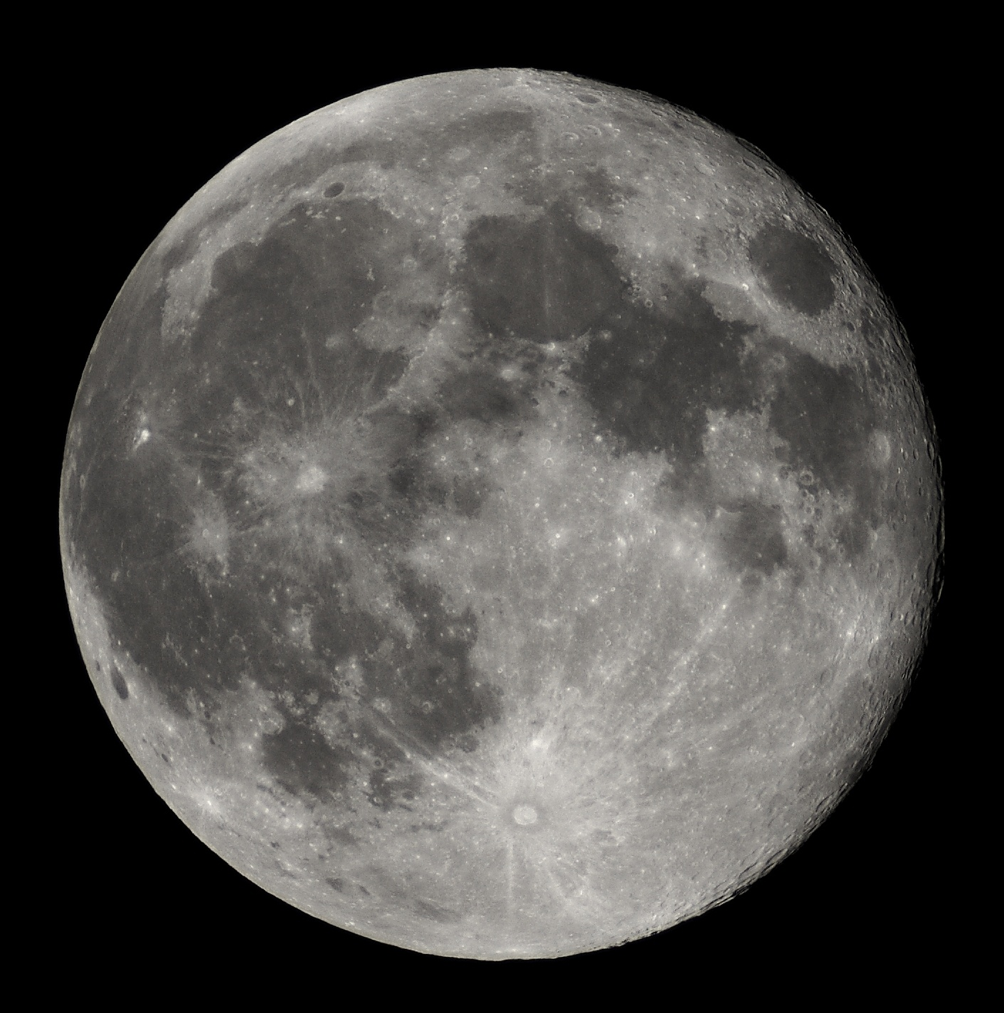
The Moon. 400,000 km (240,000 miles, 1.3 light-seconds)
Notes:
The favoured explanation for its existence is that it was formed when the Earth was very young, some four and a half billion years ago, when another large body struck the Earth and knocked a piece off. In the early life of the solar system there was a lot of left-over material floating around, and large meteorites struck the Moon, forming huge craters. Those craters were then filled with lava from volcanic eruptions, and formed the flat dark areas, called mare or seas. Many smaller meteorites also struck the Moon, and these created the craters and mountains. The same happened to the Earth, but the craters have largely been eroded away by wind and rain. On the Moon they survive because there is no atmosphere to cause erosion. The Moon is not only pretty to look at; it is vital to us. Without the Moon’s stabilising influence the Earth’s axis would flop around; there would be no regular seasons, and that would have made it much more difficult, if not impossible, for life to develop.

Slide 11
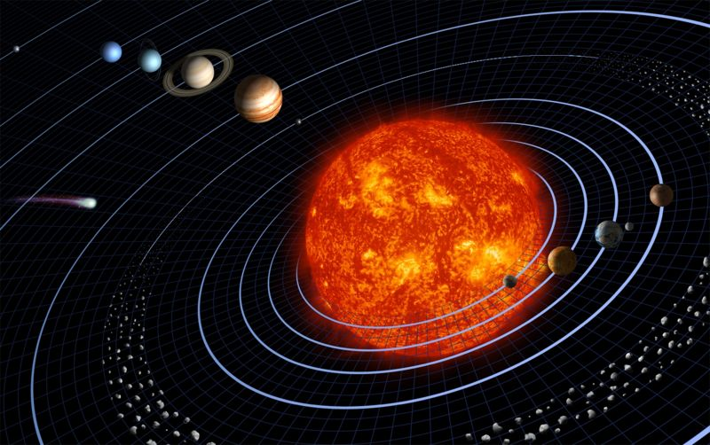
Neptune
Uranus
Saturn
(Pluto)
Jupiter
Mars
Comet
Sun
Moon
Earth
Venus
Mercury
Asteroids
Not to scale
Notes:
The solar system consists of the Sun and eight planets, including the Earth. It also includes thousands of asteroids, mostly between Mars and Jupiter. These all orbit the Sun. There are also comets, which make appearances from time to time. Note that the Earth, being the third planet from the Sun, is in the inner solar system.

Slide 12
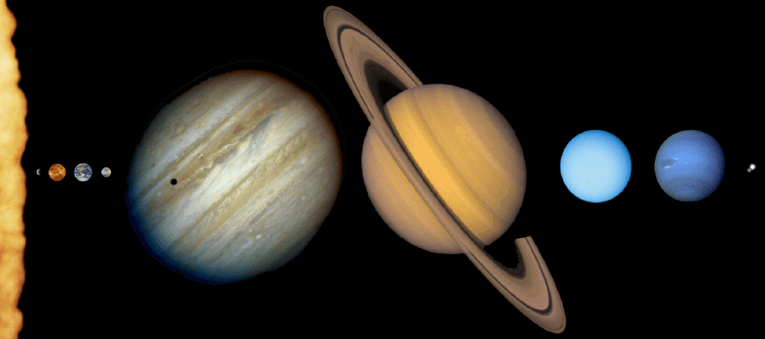
The solar system of the Sun and eight planets
(Sizes are to scale, but distances from the Sun are not to scale.)
Sun
Jupiter
Saturn
Uranus
Neptune
Mercury
Venus
Earth
Mars
My Very Easy Method : Just Stay Up Nights !
Notes:
This may be clearer in this graphic, which shows the planets at the right scale, although their distances are not. Note that the four inner planets (Mercury, Venus, Earth and Mars) are all fairly small, compared with the enormous four outer planets (Jupiter, Saturn, Uranus and Neptune). The four inner planets are rocky like the Earth, but the four outer planets are largely made of gas. There are various mnemonics for remembering the order of the planets. [CLICK] My favourite is one I made up myself: “My Very Easy Method: Just Stay Up Nights! It has the feature that not only do the words all start with the first letter of each planet, but the colon represents the asteroids, and the exclamation mark represents the comets.

Slide 13
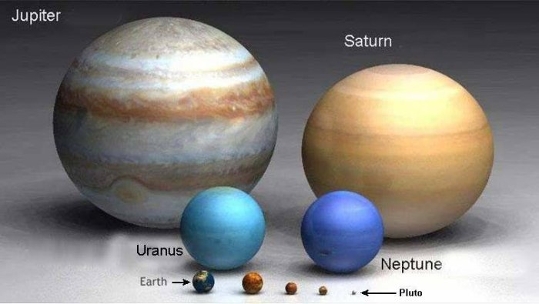
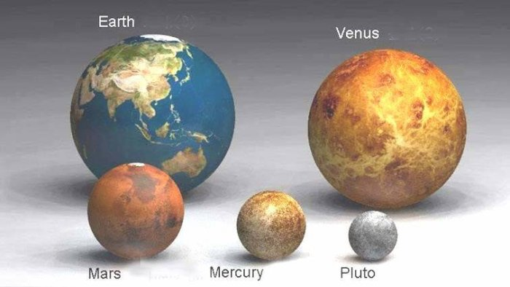
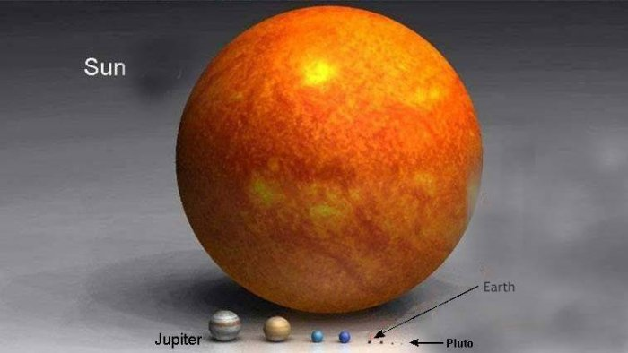
The rocky and gaseous planets
The rocky planets
The Sun and planets
Notes:
This slide shows the relative sizes of the rocky planets, including Pluto, which has been downgraded to the category of dwarf planet. I will come to the reasons why later. [CLICK] This shows both the rocky and the giant gaseous planets. [CLICK] And shows the planets compared with the Sun.

Slide 14
The Sun
150 million km (93 million miles)
= 1 astronomical unit
= 8.3 light-minutes
The Sun is 100 times the size of the Earth,
and 400 times the size of the Moon.
Earth
Moon
Sizes to scale
Notes:
The Sun is enormous compared with the planets. You could fit over a hundred Earth’s across the Sun, and it could contain a million Earths. As a normal star it is a huge ball of energy, powered by a nuclear fusion process which converts Hydrogen to Helium, releasing the heat and light upon which all life depends. Its internal temperature is millions of degrees, its surface temperature about 6000 degrees. Sunspots are lower-temperature areas associated with the Sun’s magnetic field. The Sun is about 4½ billion years old, and has a total expected lifetime of 10 billion years.

Slide 15
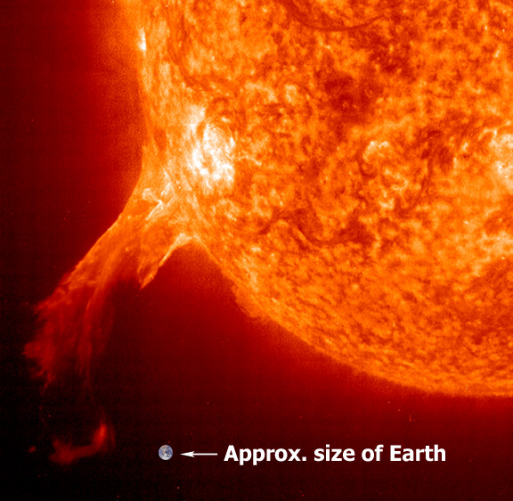
SOHO spacecraft
Notes:
The Sun surface is a seething mass, sometimes producing huge solar flares ejecting millions of tons of material into space.

Slide 16
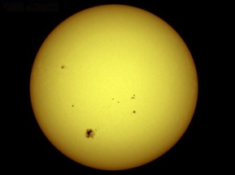
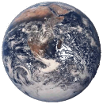
Sun
8.3 light-minutes
150 million km, 93 million miles
(one astronomical unit or AU)
Not to scale
Earth
Notes:
It is 150 million kilometres (93 million miles) away, a distance called an astronomical unit, and it takes light over eight minutes to get to us.

Slide 17
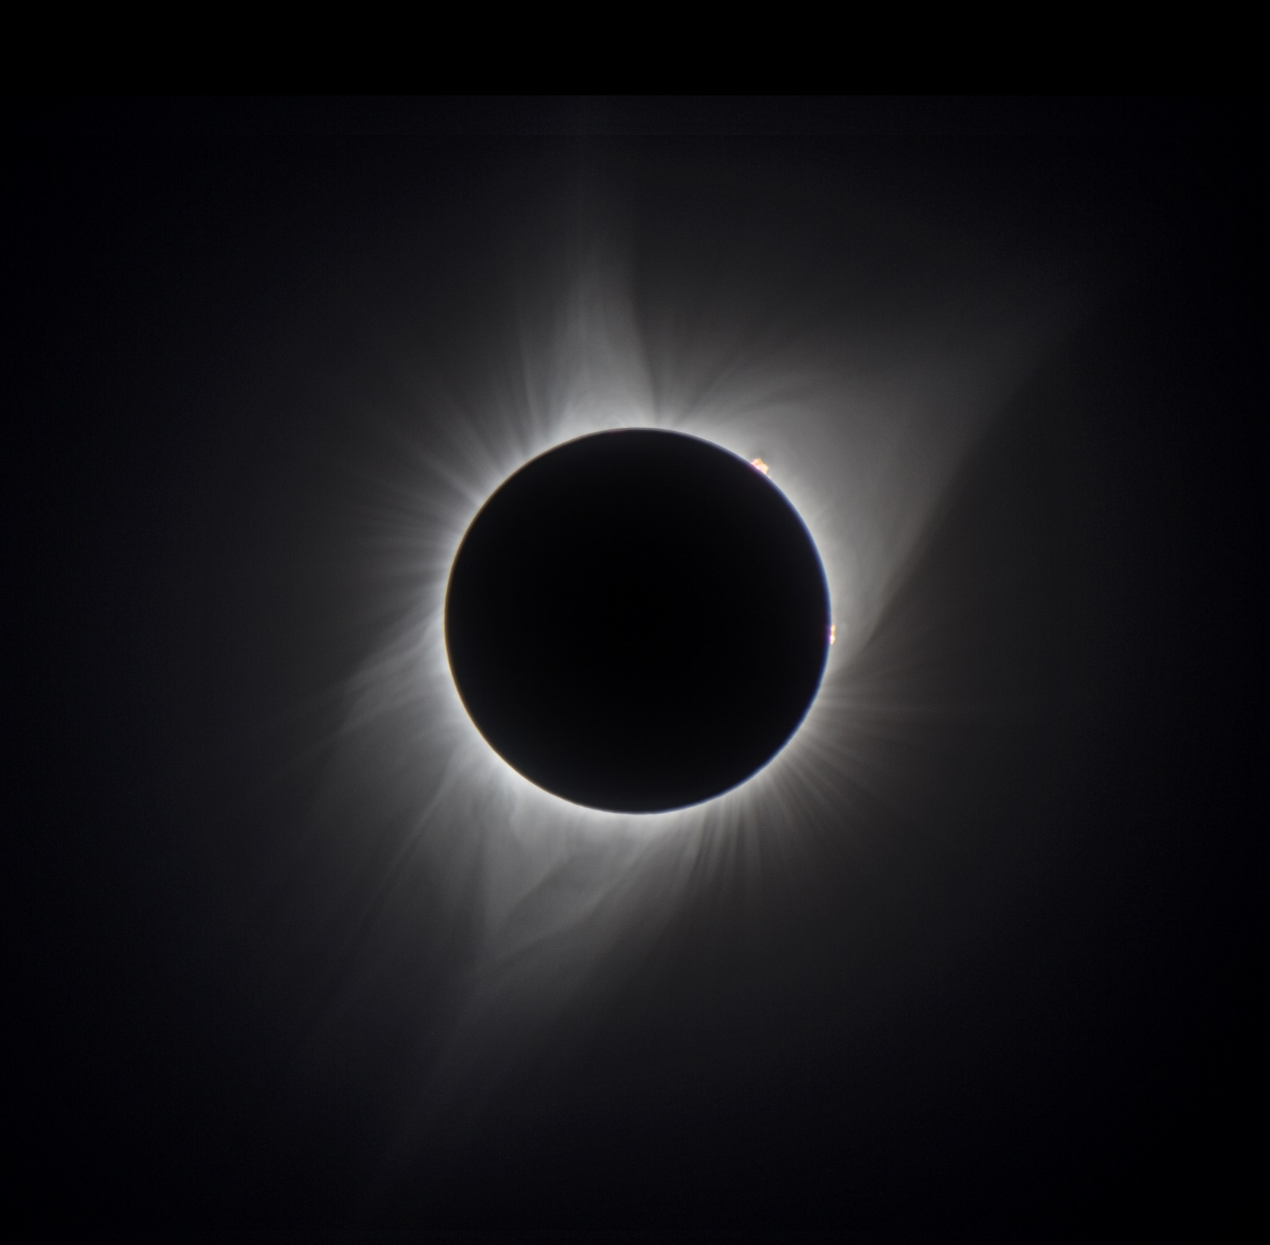
David Le Conte
Wyoming 2017
Notes:
Sometimes the Moon passes directly in front of the Sun, producing the magnificent total eclipse, and revealing the beautiful corona or outer atmosphere of the Sun. This is a stack of six pictures I took a couple of years ago during the Great American Eclipse.

Slide 18
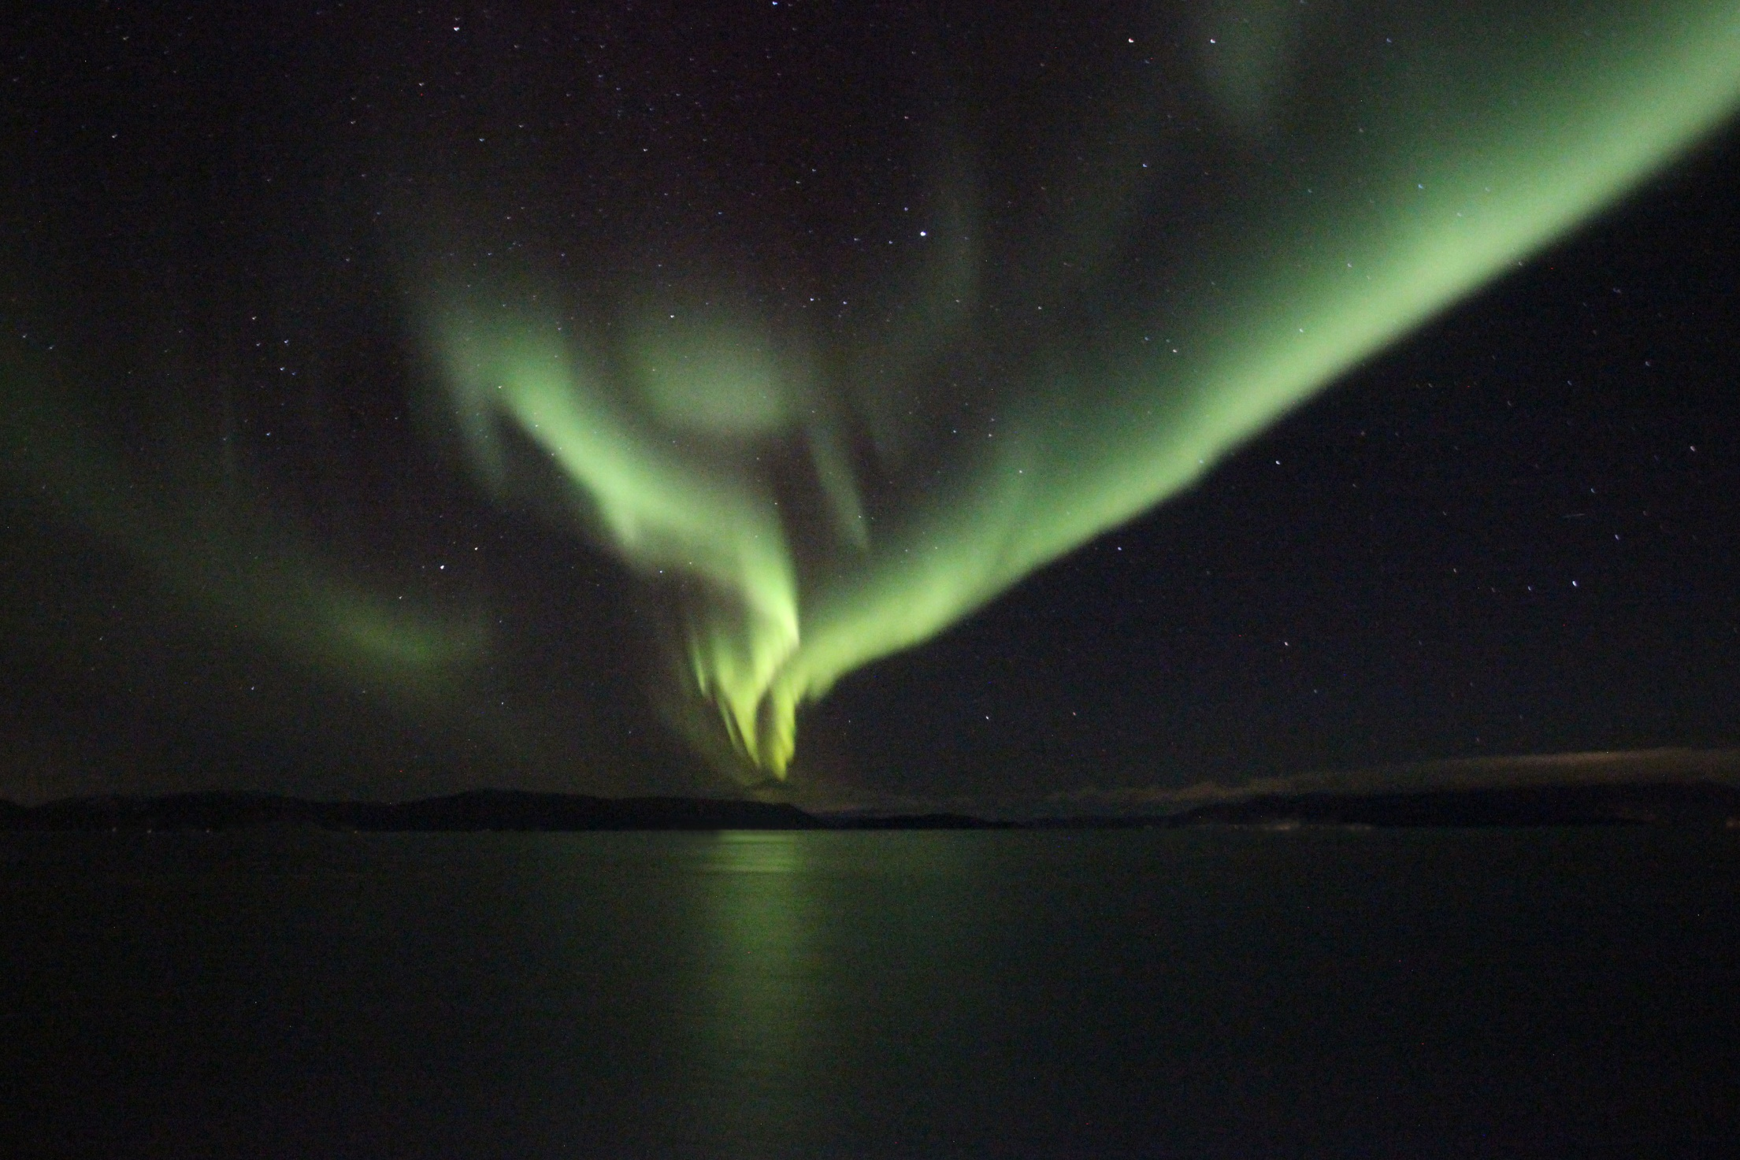
David Le Conte
Norway 2018
Notes:
The Sun’s atomic energy makes itself felt in other ways, when solar particles are affected by the Earth’s magnetic field, producing aurora or northern lights, such as this one which I photographed last year during a cruise along the coast of Norway.

Slide 19
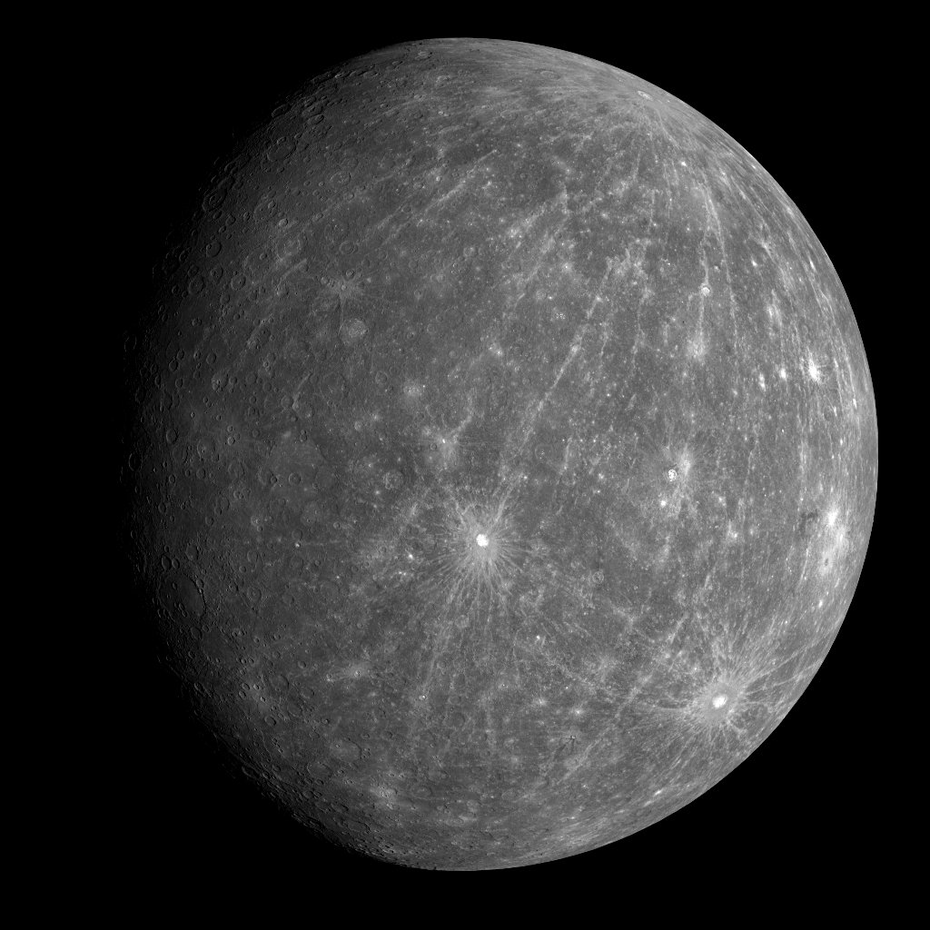
Mercury

Slide 20
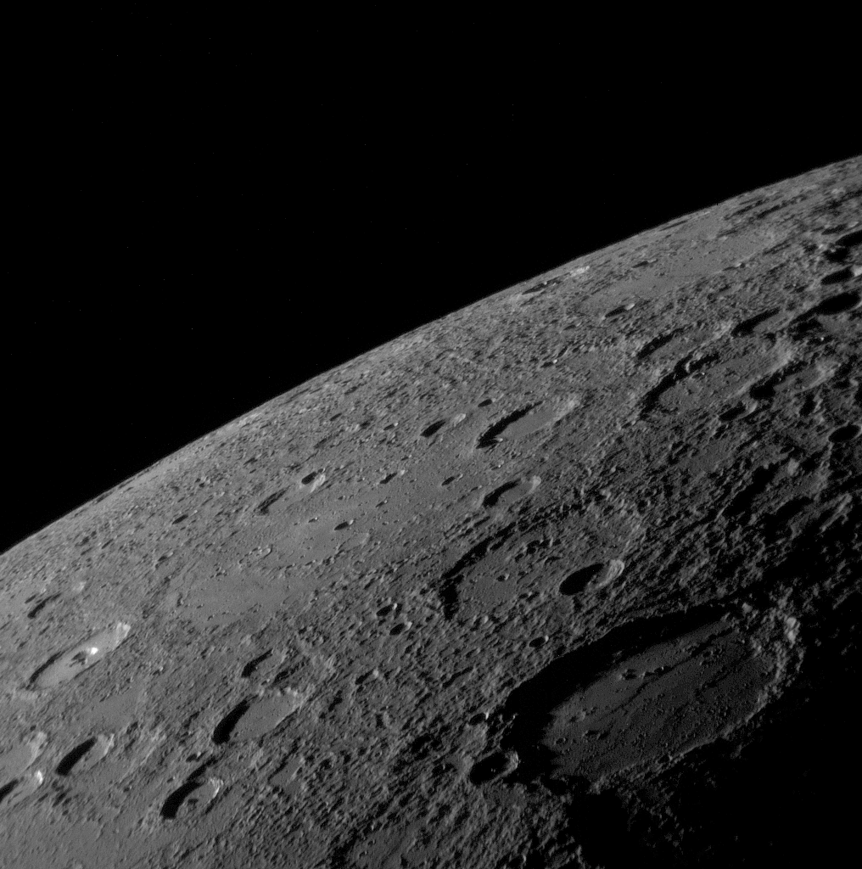
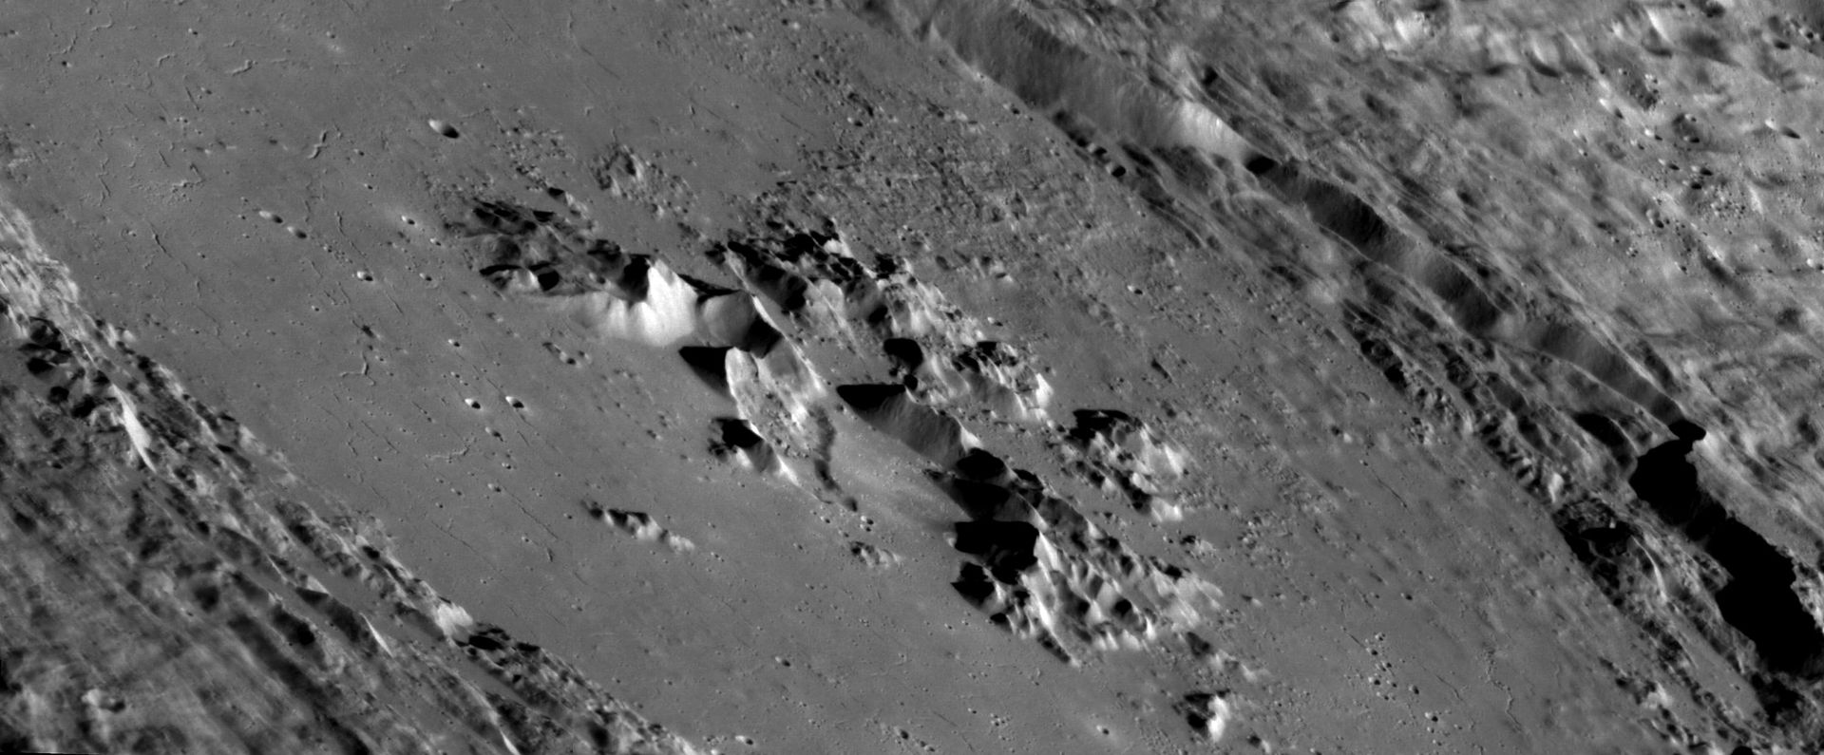
Mercury, Messenger spacecraft, 2008
Notes:
It looks superficially like our Moon, [CLICK] its surface covered with craters.

Slide 21
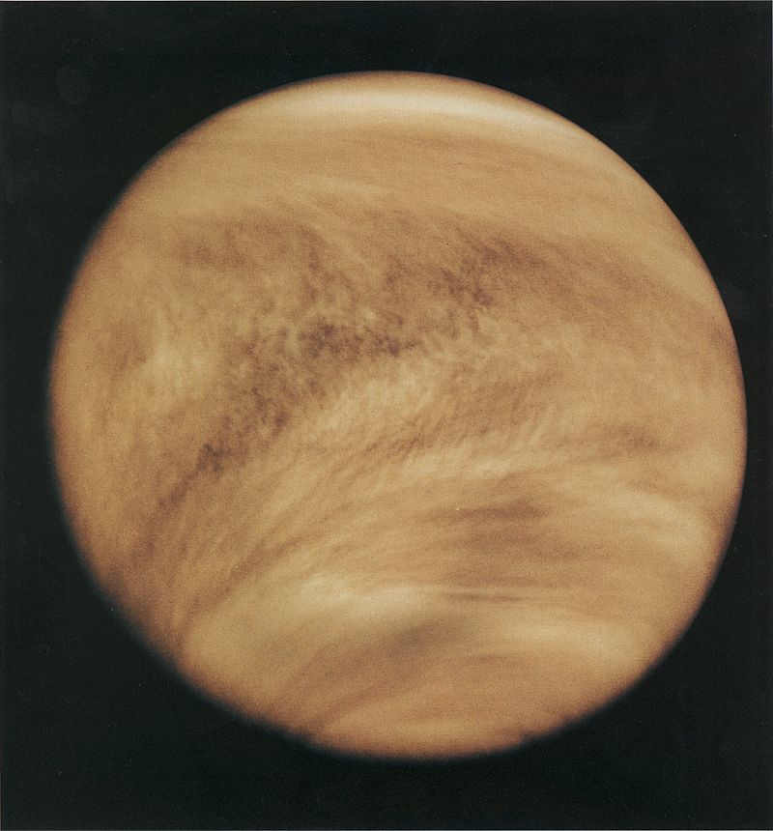
Venus
108 million km
(67 million miles)
from Sun
Pioneer Venus Orbiter
1979
Notes:
The second planet from the Sun is Venus. We can never see its surface from the Earth because it is permanently covered with dense cloud containing mostly sulphuric acid. Take my advice and do not go on holiday there. It suffers from a huge runaway greenhouse effect. Its atmosphere is almost entirely carbon dioxide. Its surface temperature is over 450 degrees. Its air pressure at the surface is over 90 times the air pressure on Earth, and it has 200 mph winds. So you would be suffocated, crushed by the air pressure, roasted, and rained on by hot sulphuric acid! Not a pleasant place!
[https://en.wikipedia.org/wiki/Venus.]

Slide 22
Venus – Radar view
Venus
Earth
Magellan spacecraft image
Notes:
Although we cannot observe the surface of Venus we do know what it looks like, thanks to radar observations from spacecraft. [CLICK] Venus is a similar size to the Earth, and can serve as a warning to us of what can happen if we allow rampant global warming.

Slide 23
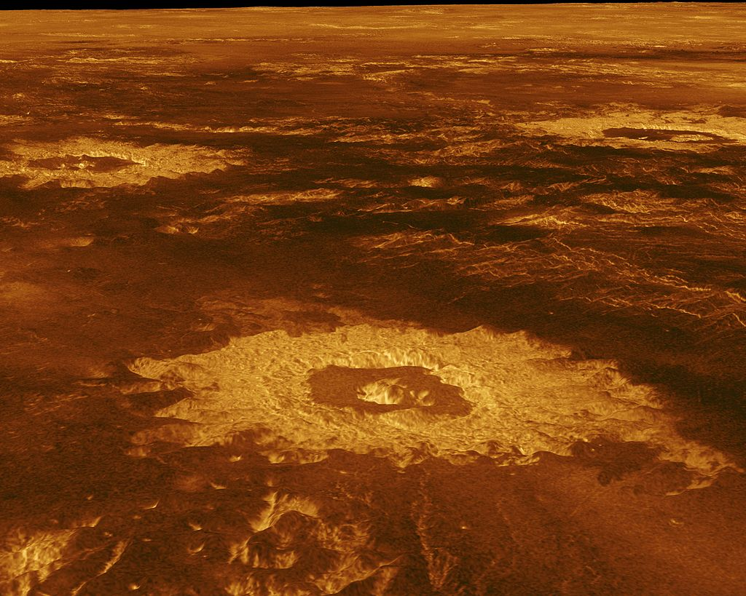
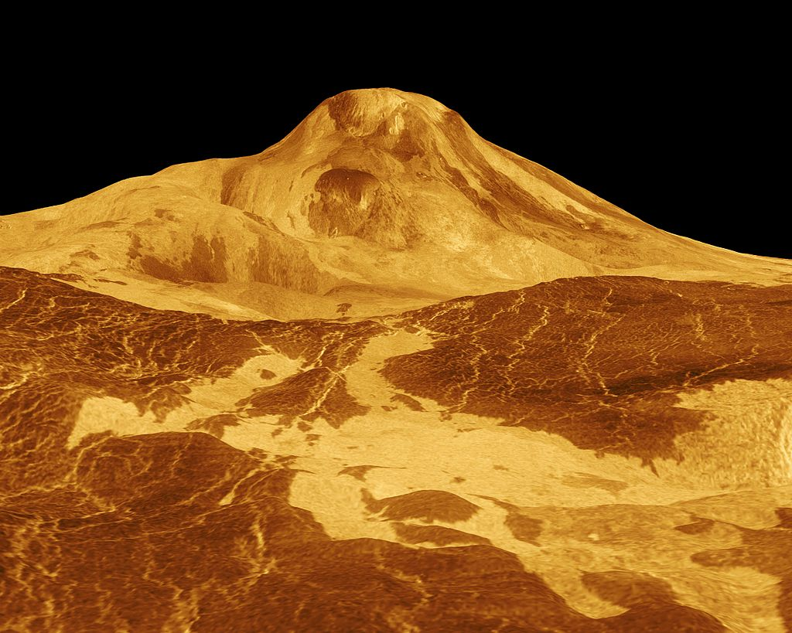
Venus – Radar view
Notes:
Venus clearly shows evidence of impact craters like those of the Moon and Mercury, and [CLICK] volcanoes which were active in its distance past.
[Magellan spacecraft radar images of Maat Mons volcano and three impact craters, 1996. See https://photojournal.jpl.nasa.gov/catalog/pia00254 and https://photojournal.jpl.nasa.gov/catalog/PIA00103.

Slide 24
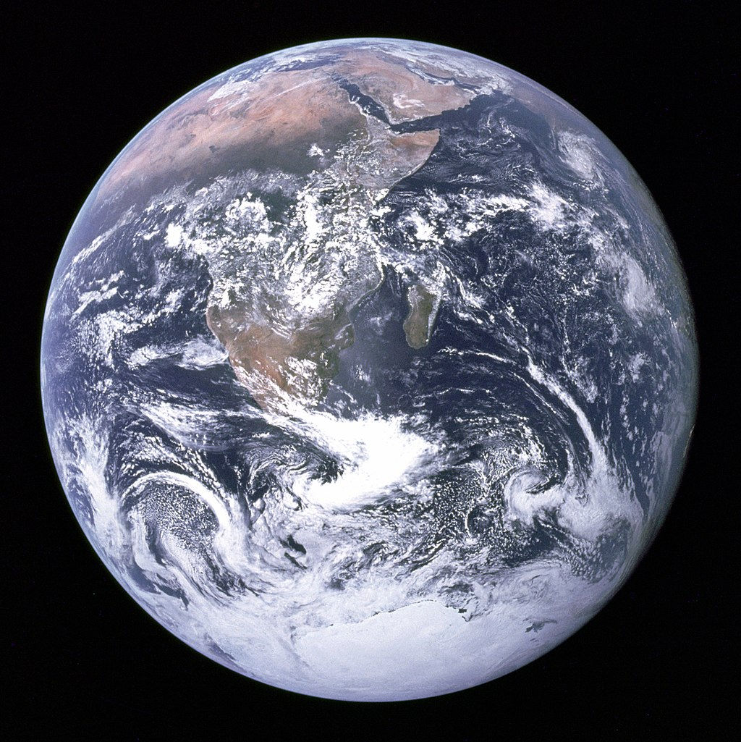
Earth – The ‘Blue Marble’
Apollo 17
1972
Notes:
Then we come to the third rock from the Sun – the Earth. Perhaps unsurprisingly it is the most beautiful planet when seen from space. It is also the only place in the universe where we definitely know that life exists, and we think some of it may be intelligent! Intelligent or not, all life depends on the very thin atmosphere, which is barely discernible in this famous ‘Blue Marble’ image taken by the Apollo 17 astronauts.

Slide 25
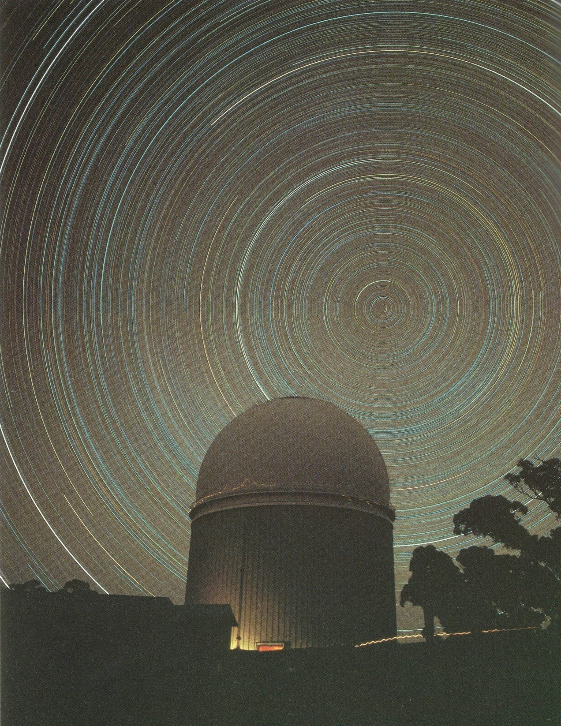
The spin of the Earth not only
Makes the Sun and Moon rise
and set, but also makes
the stars appear to rotate.
Note the different colours
of the stars.

Slide 26
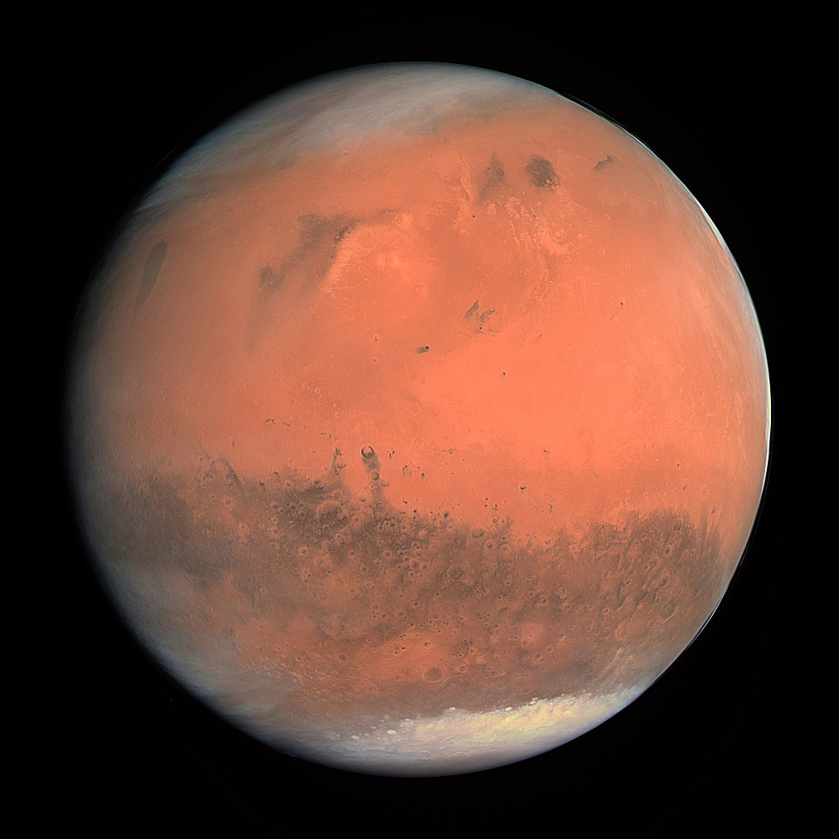
Mars– The red planet
Rosetta spacecraft
2007
Notes:
The fourth and last of the rocky planets of the inner solar system – Mars, appropriately named the red planet. Red, because it has a rusty coating of iron oxide.
[https://en.wikipedia.org/wiki/Mars]

Slide 27
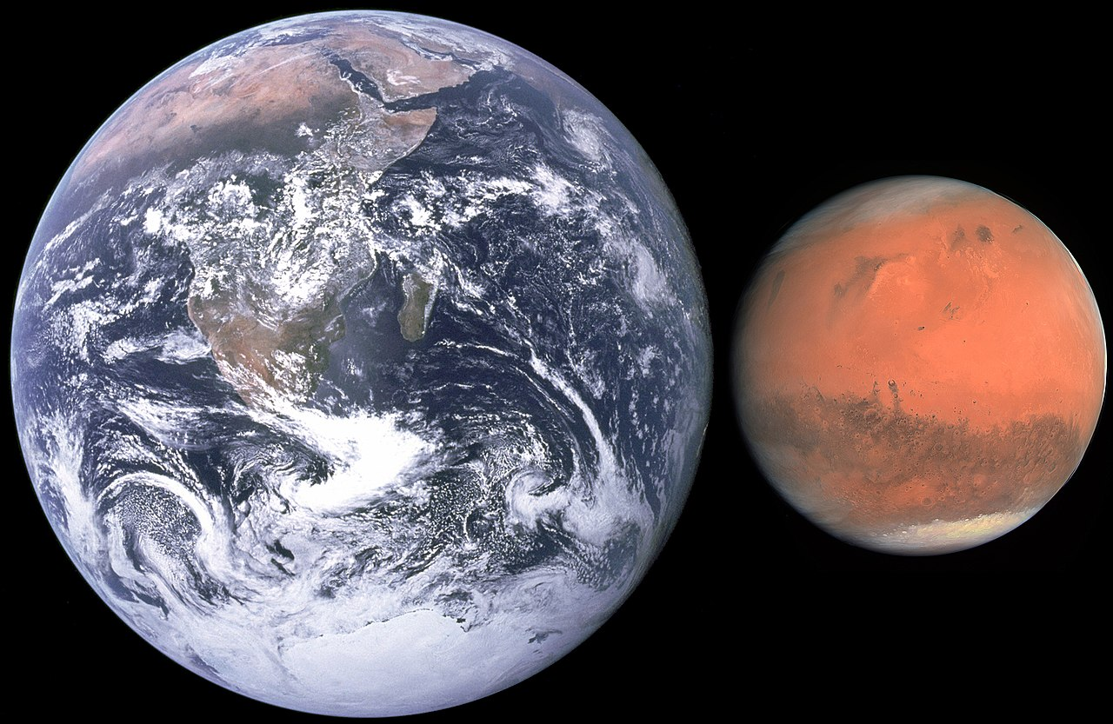
Mars
6800 km (4200 miles)
12,750 km (7900 miles)
Notes:
It is about half the size of the Earth.

Slide 28
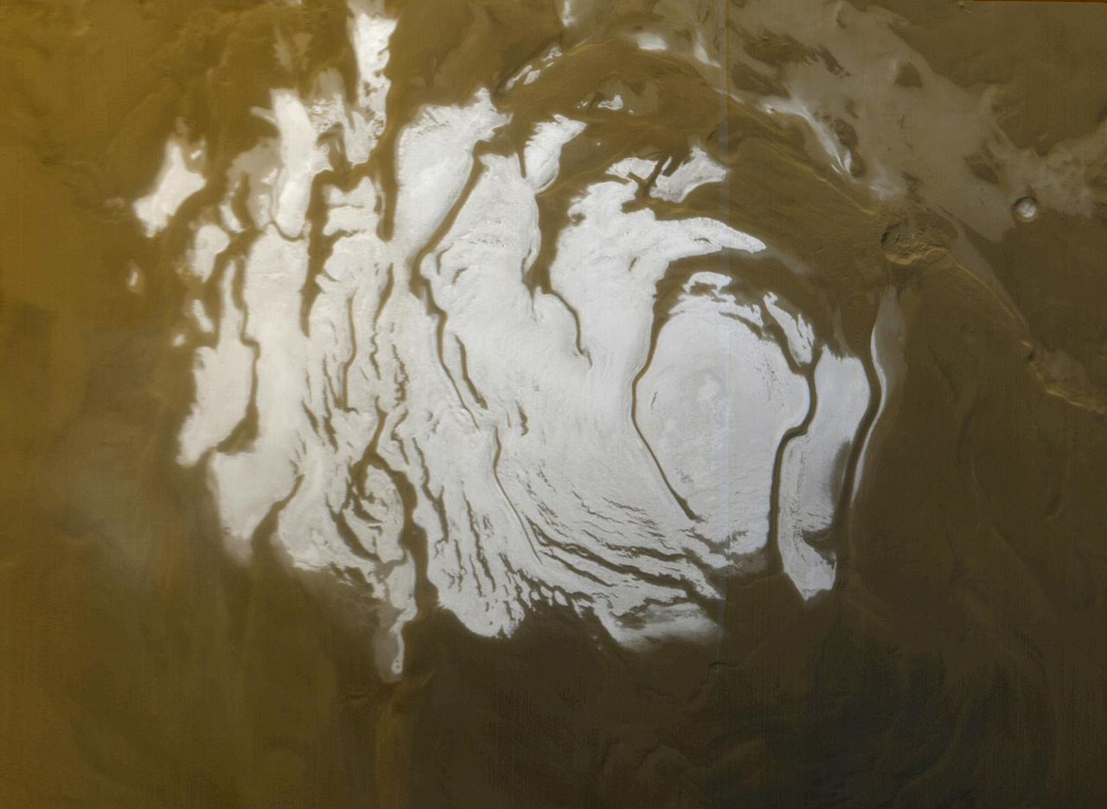
Mars South Polar cap
Notes:
It has icy polar caps, clearly visible even in small telescopes, although this image is by the Global Surveyor spacecraft orbiting Mars. And interestingly it has red daylight skies and blue sunsets.
[Mars Global Surveyor, Summer 2000.]

Slide 29
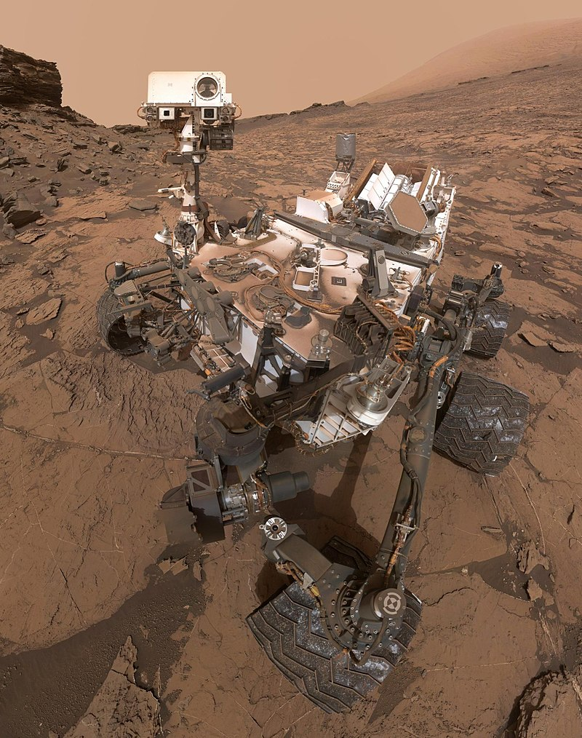
Mars Curiosity
Rover (selfie)
Notes:
And in recent years rover craft have been landed on its surface, and undertaken investigations to determine whether life of some form ever existed or may even still exist on the planet. This one is a cleverly taken selfie by the Mars Curiosity Rover.

Slide 30
Mars Curiosity Rover image, 2012
Notes:
Images returned by this craft show a landscape not unlike some of the desert areas of the Earth.

Slide 31
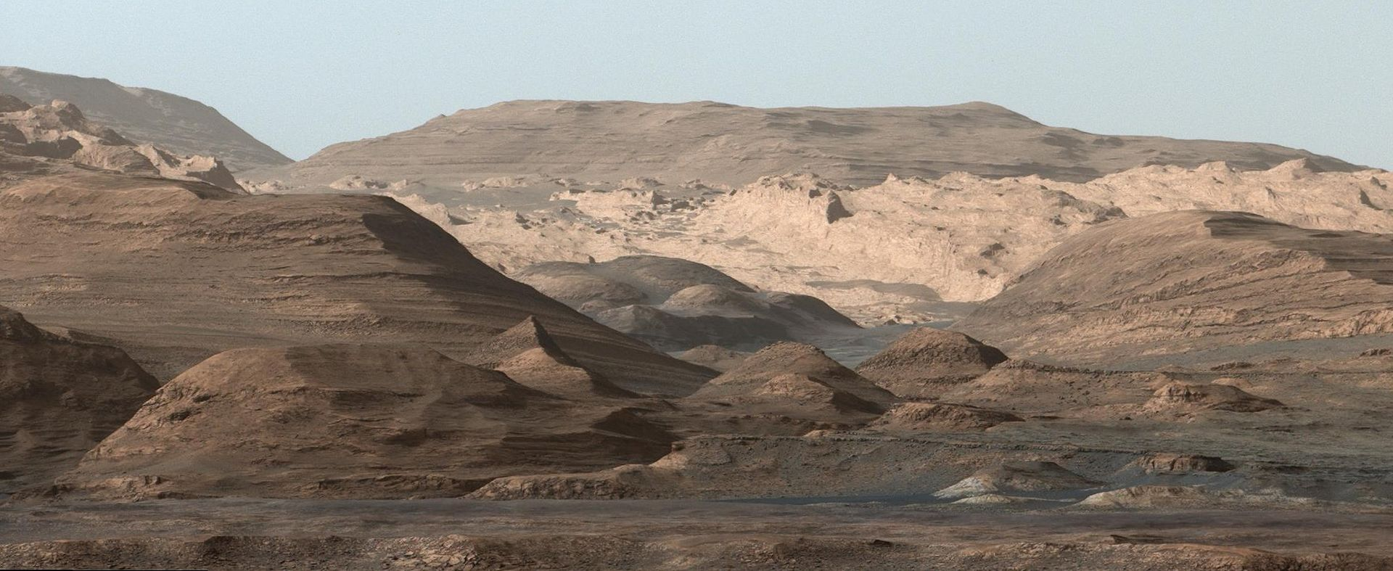
Mars Curiosity Rover image of Mount Sharp, 2015
Notes:
The geological evidence, including effects of surface water in the distant past, is clear.

Slide 32
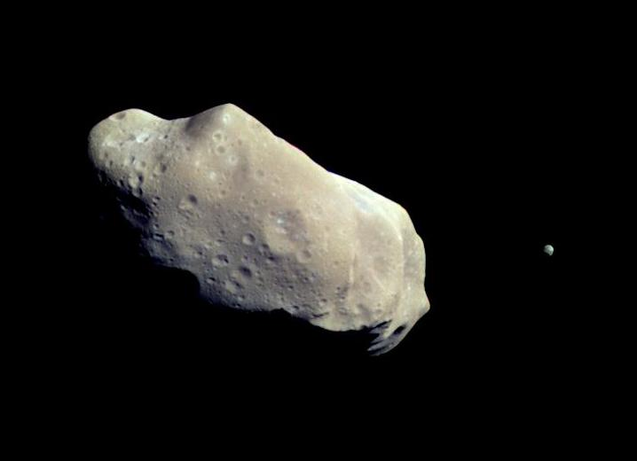
Asteroid Ida and its moon Dactyl
Notes:
Then we have the asteroid belt between Mars and Jupiter, the sizes of the millions of rocky asteroids typically ranging from a few feet to a few hundred miles. A few have been visited by spacecraft, and there is even hope that one day they might be mined for minerals.
[https://en.wikipedia.org/wiki/Asteroid]

Slide 33
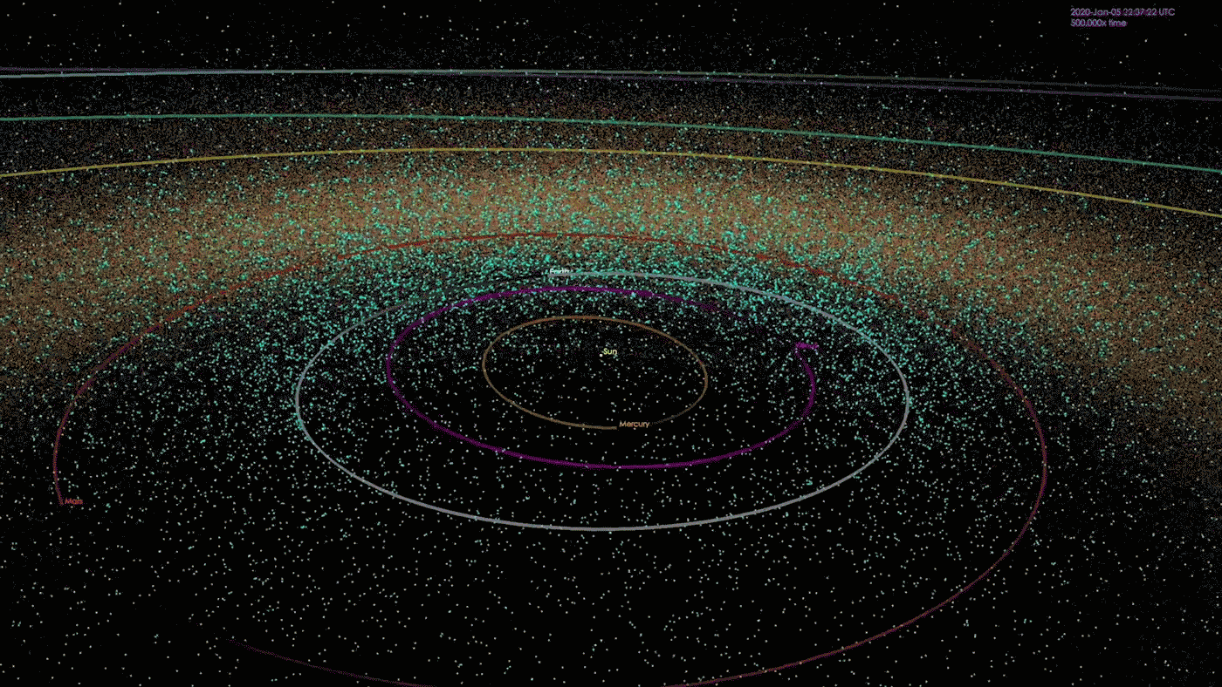
Near-Earth asteroids
Notes:
While not wanting to worry you unduly I should point out that some asteroids do cross the orbit of the Earth, as shown in this graphic. The good news is that a lot of effort is being expended to identify those which might endanger the Earth, and that so far none has been identified which is likely to collide with our planet in the foreseeable future, and that there is research into how best to deflect any asteroid which might come too close.
[https://en.wikipedia.org/wiki/Asteroid]

Slide 34
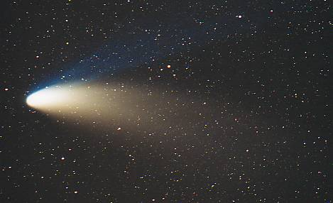
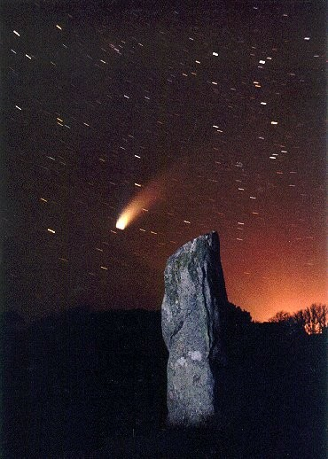
Comet Hale-Bopp
David Le Conte, Guernsey, 1997
Notes:
Other minor bodies of the solar system are comets. Many are discovered every year, but most are too faint to come to public attention. Every now and again, however, a bright one makes an appearance, and many of you will remember Comet Hale-Bopp in 1997. Here are a couple of pictures I took, one with a Neolithic standing stone. Comets are large dirty snowballs – ice with rock and dust, typically a few miles wide – which comes from the outer solar system, gets heated by the Sun, liberating quantities of gas and dust, which become the comets’ tails.

Slide 35
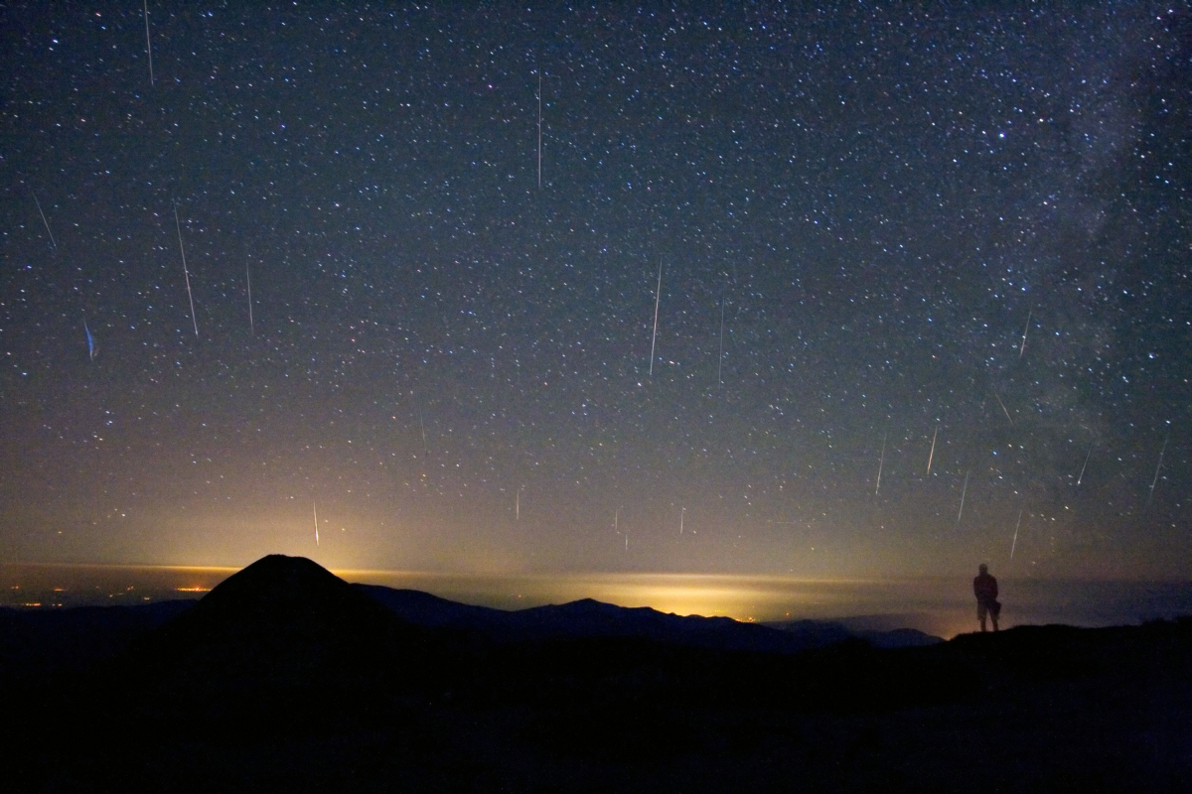
Perseid meteor shower, 2008
Alex Tudorica
Notes:
Some of that dust can enter the Earth’s atmosphere at high speed and burn up, creating meteors or shooting stars.

Slide 36
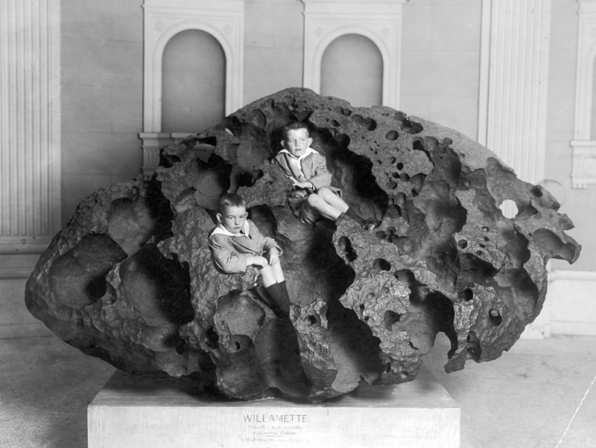
Willamette meteorite, USA
Notes:
Sometimes a piece of space rock can reach the Earth as a meteorite, the largest of which is on display in New York.

Slide 37
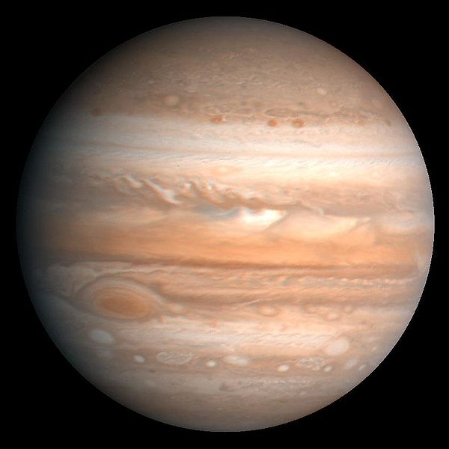
Jupiter
780 million km (500 million miles) from the Sun (5 AU, 43 light-minutes)
Notes:
The largest planet in the solar system by far is Jupiter, a gas giant with a mass three times that of all the other planets put together. It is some 300 million miles from the Sun, or five times Earth’s distance. It rotates rapidly – just ten hours, compared with our 24 hours.

Slide 38
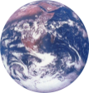
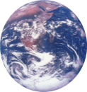
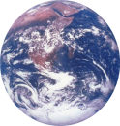
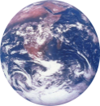
Earth at
same scale
Jupiter
Notes:
Eleven Earths [CLICK] could fit across its diameter.

Slide 39
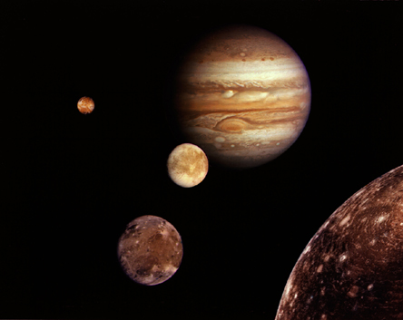
Jupiter and its four ‘Galilean’ moons
Jupiter
Io
Europa
Callisto
Ganymede
Notes:
Jupiter has 79 moons. These are the four largest. Ganymede is largest moon in the solar system. Io is the most geologically active. Callisto has a rock and ice surface, Europa has an icy surface, both with subsurface oceans and possibility of some form of life.

Slide 40
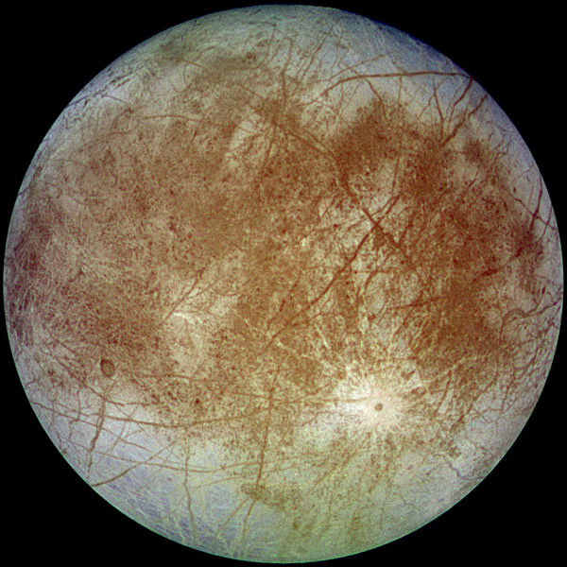
Europa
Moon of Jupiter
NASA Galileo spacecraft
Europa
Notes:
The icy surface of Europa, for example, possibly covers a huge ocean of water, holding twice as much as all the water on Earth.
It has an extremely thin oxygen atmosphere.
[Jupiter’s moon Europa also seems a possible stomping ground for E.T. due to its potential water and volcanic activity. Though the surface seems to be frozen, many suspect that buried underneath is an ocean of liquid water. Volcanic activity on the moon could provide life-supporting heat, as well as important chemicals needed by living organisms. Microbial life could potentially survive near hydrothermal vents on Europa, as it does on Earth.] http://www.wired.com/2009/01/et-life/.
https://en.wikipedia.org/wiki/Europa_(moon): Europa has the smoothest surface of any known solid object in the Solar System.^{[12]} The apparent youth and smoothness of the surface have led to the hypothesis that a water ocean exists beneath it, which could conceivably harbor extraterrestrial life.^{[13]} The predominant model suggests that heat from tidal flexing causes the ocean to remain liquid and drives ice movement similar to plate tectonics, absorbing chemicals from the surface into the ocean below.^{[14][15]} Sea salt from a subsurface ocean may be coating some geological features on Europa, suggesting that the ocean is interacting with the seafloor. This may be important in determining if Europa could be habitable.^{[16]} In addition, the Hubble Space Telescope detected water vapor plumes similar to those observed on Saturn's moon Enceladus, which are thought to be caused by erupting cryogeysers.^{[17]}
So far, there is no evidence that life exists on Europa, but Europa has emerged as one of the most likely locations in the Solar System for potential habitability.^{[103][137]} Life could exist in its under-ice ocean, perhaps in an environment similar to Earth's deep-ocean hydrothermal vents.^{[109][138]} Even if Europa lacks volcanic hydrothermal activity, a 2016 NASA study found that Earth-like levels of hydrogen and oxygen could be produced through processes related to serpentinization and ice-derived oxidants, which do not directly involve volcanism.^{[139]} In 2015, scientists announced that salt from a subsurface ocean may likely be coating some geological features on Europa, suggesting that the ocean is interacting with the seafloor. This may be important in determining if Europa could be habitable.^{[16][140]} The likely presence of liquid water in contact with Europa's rocky mantle has spurred calls to send a probe there.^{[141]}

Slide 41
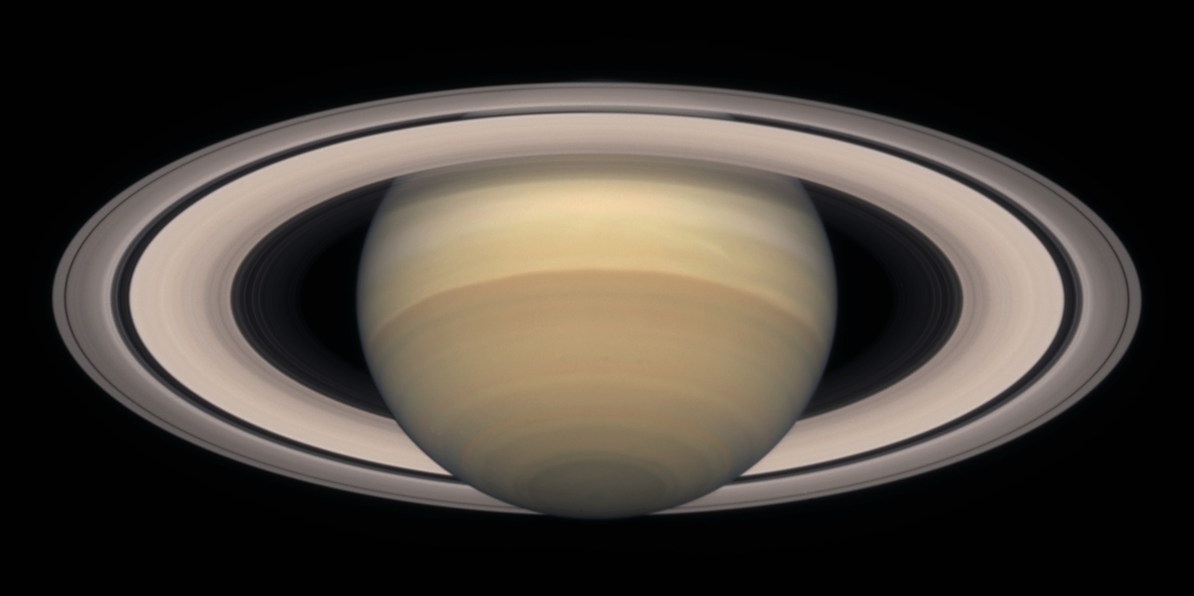
Saturn
1400 million km (900 million miles) from the Sun (9.5 AU, 80 light-minutes)
Hubble Space Telescope image
Notes:
Then we have the beautiful planet, Saturn, 900 million miles from the Sun. Another gas giant, surrounded by its stunning system of rings, which are very thin and are composed of icy bodies of varying sizes.

Slide 42
Earth
Cassini spacecraft image
Notes:
In this extraordinary picture taken by the orbiting Cassini spacecraft [CLICK] it is possible to make out the Earth some 1300 million km (800 million miles) away.

Slide 43
Saturn

Slide 44
Titan
Moon of Saturn
NASA Cassini Mission
Notes:
Like Jupiter, Saturn also has many moons, the most interesting of which is Titan. Like the Earth it has a nitrogen atmosphere, but it also contains methane, which might indicate the presence of some kind of organism.
[Saturn’s largest moon looks suspiciously like it might have hosted life, because its thick atmosphere is rich in compounds that often mark the presence of living organisms. For instance, Titan’s air is filled with methane, which is usually destroyed by sunlight. On Earth, life constantly replenishes methane, so it might similarly be responsible for the methane on Titan. Titan is rather cold, however, and if liquid water exists, it must be deep beneath the frozen surface.]

Slide 45
Uranus
3 billion km (1.8 billion miles) from the Sun (19 AU, 2.7 light-hours)
Voyager 2 spacecraft image
Notes:
Uranus, nearly two billion miles from the Sun appears a relatively uninteresting planet, but it has the peculiar feature that its axis of rotation is about 90 degrees from its orbit around the Sun, so it essentially rolls around in its orbit.

Slide 46
Neptune
4.5 billion km (3 billion miles) from the Sun (30 AU, 4 light-hours)
Voyager 1 spacecraft image
Notes:
The last of our eight planets is Neptune, which does show features in its gaseous surface.

Slide 47
Pluto
6 billion km (3.7 billion miles) from the Sun (40 AU, 5.5 light-hours)
New Horizons spacecraft image
Notes:
Poor relation Pluto, of course, has been downgraded from being a full-blown planet to something called a dwarf planet. We knew very little about this relatively small and distant ball of ice and rock until 2015, when the New Horizons spacecraft flew by it an returned extraordinary images, [CLICK] showing a landscape looking rather Earth-like, but composed almost entirely of rock-hard ice.

Slide 48
Kuiper Belt
Up to 8 billion km (5 billion miles) from the Sun (50 AU, 7 light-hours)
Notes:
The reason for Pluto being downgraded is that other Pluto-like bodies were being discovered in what is termed the Kuiper Belt, which probably contains many thousands of such objects.
[https://solarsystem.nasa.gov/solar-system/kuiper-belt/overview/.]

Slide 49
Ultima Thule (Kuiper Belt object)
New Horizons spacecraft image
Notes:
After passing Pluto the New Horizons spacecraft went on to visit one of the Kuiper Belt objects, Ultima Thule, and returned this image on the first of January this year. Even further out, surrounding the solar system, is believed to be a huge cloud of comets, called the Oort Cloud.
[http://pluto.jhuapl.edu/Galleries/Featured-Images/pics/CA06_deconvolved.png]

Slide 50
Nearest star: Proxima Centauri
4¼ light-years from Sun
Hubble Space Telescope image
Notes:
The Oort Cloud extends almost a light-year from the Sun, getting on towards the distance of the nearest star, Proxima Centauri, about four light-years away.
[Oort Cloud 2000 to 50,000 AU (0.8 light-years) from Sun.]

Slide 51
Bright stars – Distances in light-years
Betelgeuse 430
Bellatrix 243
Alnilam 1360
Rigel 777
Sirius 9
Notes:
Here are the distances of some of the brightest stars in the sky, in the constellations Orion and Canis Major. Sirius, just 9 light-years away, is the brightest star in the sky. Other stars are hundreds or thousands of light-years away. And remember that a light-year is six trillion miles!

Slide 52
Sun
Notes:
Some stars are much larger than our Sun. Here on the left is our Sun compared with Sirius, and the giant star Arcturus.

Slide 53
Arcturus
Notes:
Others are much larger yet, such as the huge Antares, here compared with Arcturus at the bottom left.

Slide 54
Notes:
Long exposure photographs in different parts of the spectrum reveal amazing features, [CLICK] such as these huge hydrogen gas clouds in the constellation of Orion.

Slide 55
Stars are born in gaseous nebulae, like the Orion Nebula, M42
Notes:
These clouds of gas and dust are stellar nurseries, where new stars are being formed. This nebula in Orion can easily be seen in binoculars as a cloud-like structure.

Slide 56
Protostars in the Orion nebula
Notes:
Some of these young stars, which may be only tens of millions of years old, have material around them which can form planets.
[Protostars (propylids) forming in the Orion Nebula.]

Slide 57
The Ring nebula in Lyra
Notes:
Stars like our Sun have a lifetime of about ten billion years. At the end of that period they balloon out into a huge Red Giant star, and then lose their outer layers, as shown in this, my favourite object, the Ring Nebula in in the constellation Lyra. The faint star in the centre is the core of the original star, and is known as a White Dwarf. So Red Giants become White Dwarfs.

Slide 58
Supernova
1987A
Anglo-Australian
Observatory
Notes:
Stars much more massive than the Sun have a far more dramatic end, exploding in a matter of seconds, in an event known as a supernova.
[Supernova 1987A by Anglo-Australian Observatory – before and after.]

Slide 59
Supernova remnant Cassiopeia A
Hubble Space Telescope
Notes:
We can see the remnants of such supernovae, such as this one in the constellation Cassiopeia.
[Supernova remnant Cassiopeia A, by HST.]

Slide 60
Crab nebula (1054 AD)
Hubble Space Telescope
Notes:
One historically supernova was that which created the Crab Nebula in the year 1054. It was recorded by the Chinese as being visible in daylight for three weeks. At its heart is the remains of the star, spinning rapidly as emitting light and radio waves as a pulsar.

Slide 61
Black hole, with companion star
Notes:
Even more massive stars can end as a black hole, so dense that nothing, not even light can escape from it. We can infer its presence if there is a nearby companion star whose material falls into the black hole with pressures and temperatures so high that it emits x-rays.
[Artist's rendition of a black hole with an orbiting companion star that exceeds its Roche limit. Mass from the companion star is drawn towards the black hole, forming an accretion disk. From http://en.wikipedia.org/wiki/Image:Accretion_disk.jpg.]

Slide 62
Globular cluster NGC 6093
Hubble Space Telescope
Notes:
Other interesting objects are huge clusters of old stars, some possibly older than the galaxies containing them.

Slide 63
The Milky Way Galaxy
Jean Dean, Guernsey
Notes:
So far we have been looking at objects in our part of our galaxy, the Milky Way. Now let’s leave our stellar neighbourhood, and venture far out into our galaxy and explore the universe of galaxies.

Slide 64
The Milky Way Galaxy
Notes:
As our solar system lies within the Milky Way galaxy we cannot see it from outside. [CLICK] We can however, draw conclusions about its shape and size by mapping the stars within it.

Slide 65
The Milky Way Galaxy. 200,000 million stars
100,000 light years
25,000 light years
Sun
Notes:
This shows that it has a spiral shape, and is about a hundred thousand light-years across, our Sun and solar system lying 25,000 light-years from the centre of the galaxy.

Slide 66
Central 900 light-years of the Milky Way Galaxy (Infrared image by Spitzer Space Telescope)
Notes:
Of particular interest is what goes on in the centre of the galaxy. Here is the central 900 light-years, imaged in infrared by a special space telescope.

Slide 67
Central 300 light-years of the Milky Way Galaxy
Composite infrared image by Hubble and Spitzer Space Telescopes
Notes:
And here is the central 300 light-years. By studying the motions of stars close to the centre we can deduce that it contains a supermassive black hole, perhaps several million times the mass of the Sun.

Slide 68
Artist’s impression of a supermassive (4 million Mʘ) black hole at the centre of the Galaxy
Notes:
Here is an artist’s impression of what is might look like if we could get close enough.
[For video see: https://en.wikipedia.org/wiki/Supermassive_black_hole.]

Slide 69
Large Magellanic Cloud
160,000 light-years distant
Notes:
We see thousands of other galaxies, the closest to us being naked-eye objects visible from the southern hemisphere, and discovered by Magellan.

Slide 70
Large Magellanic Cloud
160,000 light-years distant
Notes:
We see thousands of other galaxies, the closest to us being naked-eye objects visible from the southern hemisphere, and discovered by Magellan.

Slide 71
M51 Whirlpool galaxy
Notes:
We can also evidence of star formation in other galaxies. The pink areas are clouds of hydrogen gas like the Orion nebula, where new stars are being born.

Slide 72
The Needle Galaxy
Notes:
Seen edge-on spiral galaxies reveal themselves to be quite flat and relatively thin, apart from the central bulge which consists mostly of old stars.
[NGC 4565 spiral galaxy.]

Slide 73
Andromeda galaxy
2.2 million light-years
(24 million trillion km, 15 million trillion miles)
Andromeda galaxy
Notes:
The furthest object we can see with the naked eye, and easily visible in binoculars, is the magnificent Andromeda Galaxy, over two million light-years away, or 15 million trillion miles. It is on a collision course with our Milky Way galaxy, so watch out for some celestial shenanigans in about four billion years.

Slide 74
M101 galaxy
Notes:
M101 galaxy, by HST.

Slide 75
Colliding galaxies NGC 2207 and IC 2163
Hubble Space Telescope
Notes:
We can see such collisions happening between other galaxies …
[Galaxies NGC 2207 and IC 2163, by HST. ]

Slide 76
M87 galaxy in the Virgo galactic cluster.
55 million light-years
Notes:
… resulting in a large egg-shaped galaxy, devoid of new star formation. This one is at the centre of a cluster of some 500 galaxies, and we can see many such clusters, some superclusters containing far more galaxies.

Slide 77
Hubble Ultra Deep Field
13 billion light-years.
Notes:
Galaxies permeate the entire universe. This extraordinary image, taken by the Hubble Space Telescope, is of a tiny area of the sky, and shows thousands of galaxies, some formed not long after the universe itself came into being nearly 14 billion years ago. It is estimated that on average each galaxy contains 100 billion stars, and there may be 100 billion galaxies in the universe. That’s an awful lot of stars!
[Hubble Ultra-Deep field. Located southwest of Orion in the Southern-Hemisphere constellation Fornax at right ascension 3h 32m 40.0s, declination -27° 47' 29" (J2000), the image covers 36.7 square arcminutes[2]. This is smaller than a 1 mm by 1 mm square of paper held 1 meter away, and equal to roughly one thirteen-millionth of the total area of the sky. The image is oriented such that the upper left corner points toward north (-46.4°) on the celestial sphere. The star near the center of the field is USNO-A2.0 0600-01400432 with apparent magnitude of 18.95. In total, the image required 800 exposures taken over the course of 400 Hubble orbits around Earth. The total amount of exposure time was 11.3 days for the ACS and 4.5 days for the NICMOS.]

Slide 78
Can you see the stereoscopic effect?

Slide 79
This presentation has been brought to you by
the Astronomy Section of La Société Guernesiaise,
Guernsey, in the British Channel Islands.
For more astronomical presentations go to:
http://www.astronomy.org.gg/more/resources/education

